Slide 1
International Trade Club of Chicago
SIS Kenneth J. Muellner
Port of Chicago (Rosemont) IL
IMM CEE Buffalo NY
10/23/2015

Slide 3
Notes:
In February 2014, the President signed an Executive Order mandating completion of the Single Window and use by all agencies will a role in trade processing by the end of 2016.
The Single Window isn’t a new concept. There are 47 agencies who play a role in the facilitation of cargo.
Each agency has it’s own processes, forms and systems.
The Single Window is the concept of creating one system through which the trade will submit their data and the Government will make release determinations.
ACE is being built to be that Single Window.
The trade will submit the data needed by all agencies once, and ACE will take that data, pull out the data required by each agency and push that data to the agency.
Benefits are great for both Government and industry – less paper, faster decision making, greater risk assessment capabilities.

Slide 4
Key Dates for ACE Transition
Deployment of Key ACE Capabilities
February 27, 2016
Deploy remaining entry/entry summary types to production
May 20, 2015
Functionality for Nov. 1 delivered to CERT environment for trade testing
January 2015
Electronic import manifest for air and export manifest for air/ocean/rail
July 2, 2016
All remaining core trade processing capabilities delivered
August 2015
Begin rollout of PGA pilot
2015
2016
May 1, 2015
ACE mandatory for all electronic manifest filings
November 1, 2015
Transition period begins: ACE filing of electronic entry and associated entry summary types 01, 11, 03, 51, 52 with or without PGA data is encouraged
February 28, 2016
ACE must be used and ACS will no longer be available for filing of all electronic entries and associated entry summaries. In addition, electronic FDA, NHTSA, APHIS (Lacey) data must be filed in ACE
July 2016
Upon publication of the Final Rule, ACE must be used for filing AMS, APHIS Core, ATF, CDC, DCMA, DDTC, DEA E&C, EPA, FSIS, FWS, NMFS and TTB data. Hybrid submissions will no longer be allowed
October 1, 2016
ACE mandatory for all remaining electronic portions of the CBP cargo process
ACE Mandatory Dates
Notes:
Over the last several months we received multiple requests from the trade community, including the Trade Support Network Trade Leadership Council, National Customs Brokers and Forwarders Association, and the CBP Commercial Operations Advisory Council, requesting that CBP re-evaluate the mandate timeline to file electronic entry/entry summaries, with PGA data, in ACE.
Working in close coordination with the Department of Homeland Security, the Border Interagency Executive Council, and the White House, we have been actively tracking and assessing stakeholder readiness for the mandatory filing of all electronic entry and entry summaries in ACE. The trade community has not been transitioning to ACE Cargo Release filings at a rate that would give us confidence that all filers would be ready for a full transition in November. The trade community set forth many reasons for this:
PGA pilots are just starting and the functionality is new; the trade was concerned that August to November would not provide them enough time to prepare for the full transition
We determined that a longer period of time for phasing in the mandatory filing of data related to specific PGAs via ACE would give all stakeholders, us included, additional time to test and train
Filers will be able to file data for all piloted PGAs in ACE on November 1.
If they can’t file for all of the PGAs, then we are encouraging them to file what they can.
More people we have filing between now and July 2016 the greater our chance of success will be.
New timeline
Nov 1, 2015: Beginning of a transition period for electronic entry and entry summary filings in ACE to allow industry and participating government agencies more time to test and provide feedback as they fully transition into the new system. Use of ACE is allowed and encouraged for electronic entry and corresponding entry summary filings for entry types 01, 03, 11, 51, and 52 with or without PGA data.
Feb 28, 2016: At this time, filers will only be permitted to file in ACE, and no longer permitted to file in ACS, all electronic entries and entry summaries. In addition, electronic FDA, NHTSA, and APHIS (Lacey) data must be filed in ACE and ACS will no longer be available.
July 2016: Upon publication of the Final Rule, ACE must be used for filing AMS, APHIS Core, ATF, CDC, DCMA, DDTC, DEA E&C, EPA, FSIS, FWS, NMFS and TTB data. Hybrid submissions will no longer be allowed
We would like to reiterate that the transition period initiated on November 1, 2015 does not impact our December 2016 deadline for full implementation of the Single Window via ACE.
CERT Testing
As a reminder:
The majority of all code to support testing by all trade filers for mandatory date capabilities has been deployed.
CBP strongly recommends trade filers work with their Client Reps to test new and existing entry and entry summary capabilities (including entry/entry summary types 01, 03, and 11).
Implementation Guides for the capabilities are posted to CBP.gov/ACE.

Slide 5
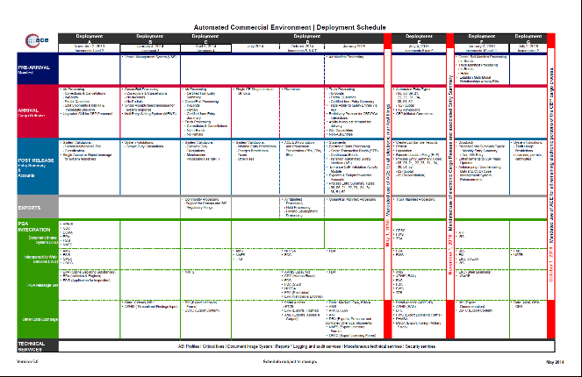
ACE Remaining Deployments
CBP has continued to make
strong progress on the ACE
development schedule
5 of 7 deployments issued
Dates for final 2 deployments are:
Full schedule of development is available on cbp.gov/ace
Deployment F | Deployment G
October 31, 2015 January 9, 2016 February 27, 2016 | July 2, 2016
http://www.cbp.gov/document/guidance/ace-development-and-deployment-schedule
Notes:
CBP is using the Agile software development methodology to complete development of core trade processing features in ACE and decommission the corresponding capabilities in legacy systems by the end of 2016.
Internally, we were able to determine that the adjustment to the mandatory dates timeline does not put us behind schedule from a technology development standpoint.
We did modify deployment dates to match up with the new schedule
Specifically, we had to move the deployment of the additional entry types that may have quota implications from October 31st to February 27th. We cannot operate these in two systems because it would result in an unfair advantage for those filers able to file in ACE sooner. These capabilities are already built – they have been in our certification environment for testing by software developers since May 20th. (with the exception of type 06s)
We would like to reiterate that this will not impact our ability to meet the 2016 deadline from the Executive Order for implementing the single window.

Slide 6

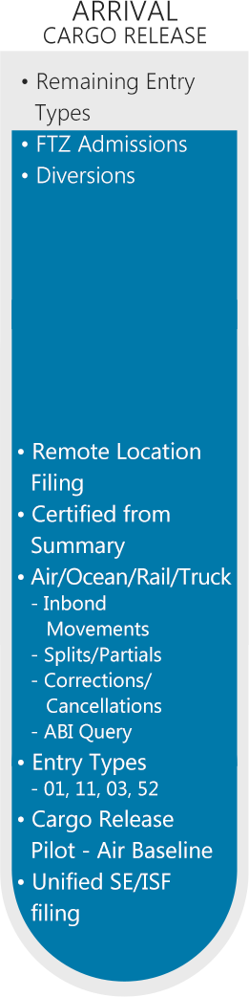
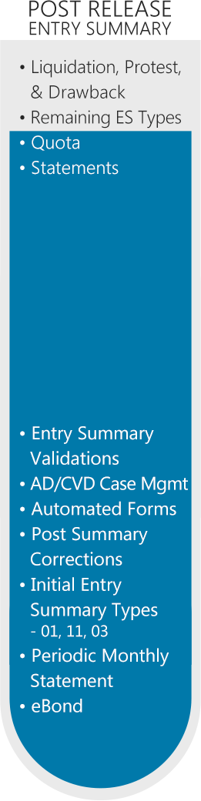
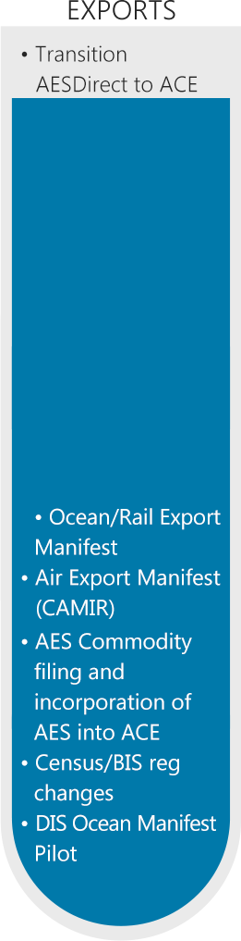
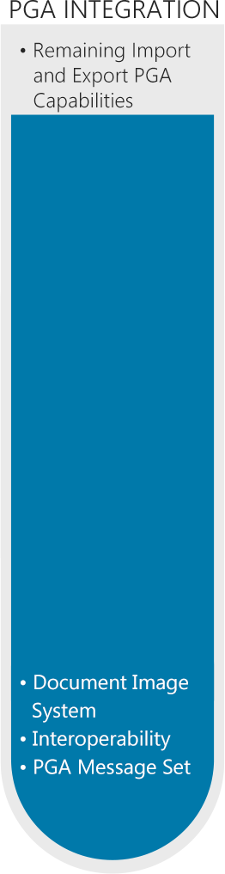
ACE Progress
Notes:
Now let’s talk about specific functionality that has been delivered in ACE and is still to-be-built.
Here are the details of what we’ve deployed thus far.
100% of Import Manifest functionality is now in ACE.
All electronic truck, ocean, rail and air manifests must already be filed in ACE.
More than 90% of core Cargo Release processing capabilities have been delivered in ACE.
We’ve expanded ACE Cargo Release for 01, 03, 11, and 52 at all ports for all modes of transport.
Benefits of ACE Cargo Release include:
Eliminate submitting paper Form 3461 (entry document)
File shipment data prior to carrier notifying CBP of departure
Receive status updates prior to cargo arrival
No need to submit corrections through a paper form
Make corrections to cargo entry data electronically
More than 80% of Post Release capabilities are in ACE.
Entry types 01, 03, 11, 51 and 52 can be filed in ACE, representing almost 99% of entry summaries filed.
Entry summary validations, identified as a top priority by brokers, have been significantly expanded in ACE.
Benefits of ACE Entry Summary filing include:
Eliminate submitting Form 7501 (paper entry summaries)
Request ACE cargo entry certification from ACE entry summary
File Antidumping/Countervailing Duty entry summaries (Entry Type 03) using Remote Location Filing (RLF)
Process Census warning and overrides electronically through ACE
Transmit Post Summary Corrections (PSC) electronically, receive refunds quicker
Gain access to an expanded AD/CVD query
Obtain more information from the ACE Entry Summary query
More than 90% of export processing functionality has been deployed in ACE.
The Automated Export System (AES) is now part of the ACE platform.
Pending the issuance of a Federal Register Notice, a pilot will be initiated for electronic air, ocean and rail export manifest capabilities.
More than 80% of Single Window integration capabilities have been deployed in ACE.
We’ve delivered the core technical foundation for the Partner Government Agencies (PGAs), and are now focused on integrating PGAs in ACE.
We are actively working with PGAs that have requirements at time of entry or entry summary to ensure readiness and meet the July 2016 deadline.
Recently deployed capabilities include:
Mail, Passenger and Pipeline Entries
Entry Type 52
Entry Summary Types 51 & 52,
Remote Location Filings
Non-ABI
Single Pay Option for ACE ES
Refactored ES Types 01, 03, & 11
Next deployment is scheduled for October 31st.

Slide 7

ACE at a Glance: Estimated Data for August 2015
Requirement: 100% of eligible electronic entries and associated entry summaries filed in ACE by February 28, 2016
Cargo Release
Entry Summary
36
Software Providers
95%
Certified
100%
Certified
3,144
95.3% Approved
Total
Filers
100%
Approved
Submission Rates
4.5%
64.5%
Notes:
These are our anticipated trade onboarding statistics as of the end of August.
We did make progress – we are up to almost 99% of filers being approve to file ACE cargo release. We have all filers approved for entry summary filings.
As far as actual filing rates go – in August nearly 64.5% of all electronic entry summaries were filed in ACE – a .4% decrease.
Cargo release filings, reached 4.5% up from 3%. Those rates are still low and we are continually working with the trade to increase participation in ACE cargo release filings. As we expand the PGA pilots, we are expecting these numbers to increase.

Slide 8
Getting Started with ACE
New to electronic filing?
Already an established filer?
Identify your method of connection:
  Use an approved software provider
  Contract with a service provider
  Develop software in-house
Set up connection:
  Fill out an submit a Letter of Intent
  Coordinate an assigned client representative
Confirm with your software provider, broker or service center about their ability to file cargo release, entry summary or manifest transactions to ACE
Contact your client representative and express your interest to file through ACE
www.cbp.gov/trade/automated/getting-started
Notes:
Start using ACE now and be ready when those dates arrive.
Importers: If your entry summaries aren’t being filed in ACE, talk to your broker about WHY they’re not filed in ACE, and WHEN the broker will file your entry summaries in ACE.
Brokers: If your software vendor hasn’t provided software for ACE filing, find out WHEN they will have the software in place to support ACE filing.
Don’t assume entries are filed in ACE. Confirm with vendor that they are going to ACE and not ACS.

Slide 9
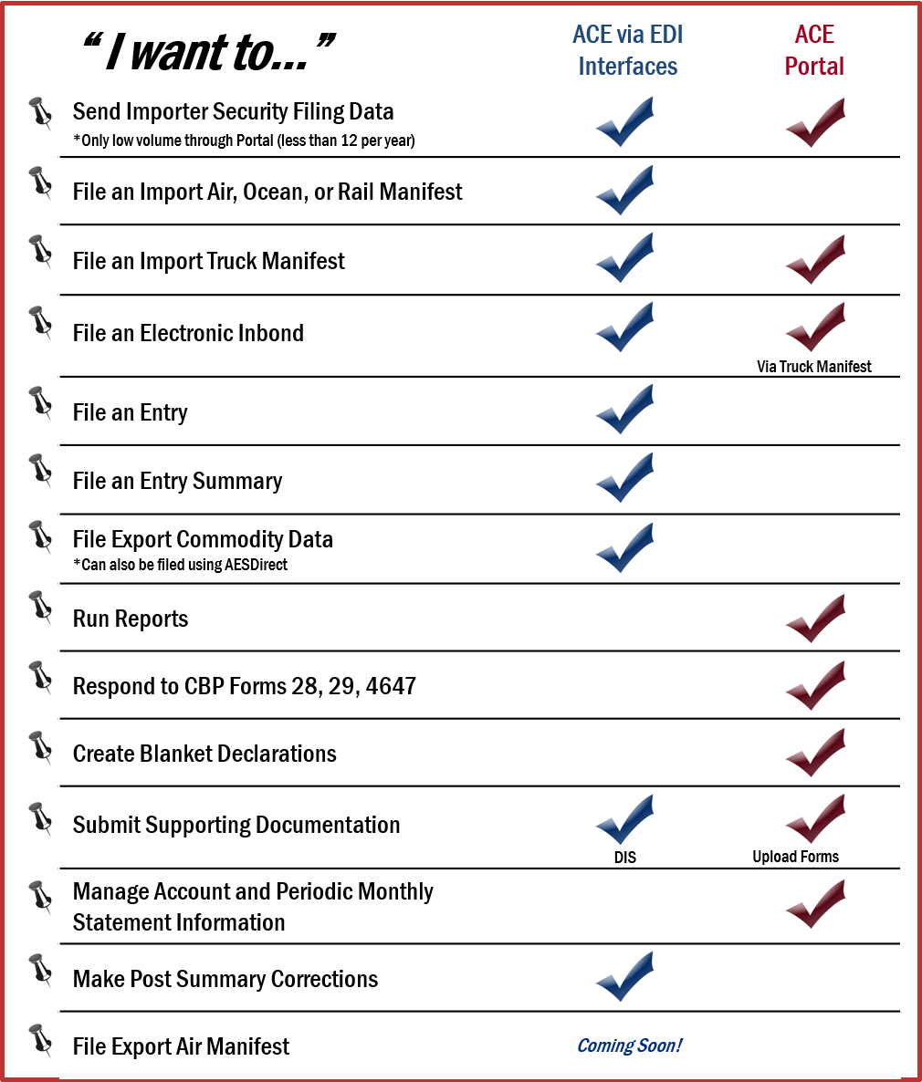
ACE: EDI v Portal
Filing data with ACE:
  Submit import and export data in accordance with ACE technical standards through Electronic Data Interchange (EDI)
Once data is submitted to CBP, use the ACE Portal to:
  Evaluate compliance and monitor daily operations
  Access to more than 400
  reports
  Submit truck import manifests
  Monitor data on file with CBP

Slide 10
Benefits of Filing with ACE
Manifest Submissions
File electronic truck manifests (include ACE Portal filing)
Designate authorized partners who can use carrier custodial bonds
Receive enhanced visibility of cargo status
Reduce wait time at Ports of Entry
Entry Submissions (Cargo Release)
Streamline submission of data elements
Remove requirement to file paper CBP Form 3461
Entry Summary Submissions
Increase traceability for audit and expedite release via eBond
Replace paper processes with electronic post summary corrections
Reduce invoice transmissions through Census Overrides
Exports
Generate reports of up to 5 years of export data
Incorporate of Bureau of Industry and Security (BIS) license control updates
Incorporate Census regulatory changes
Periodic Monthly Statement
Pay duties & fees on monthly basis
Consolidate entry summaries for a month on one statement
Track activity with customized account views
Quicker Receipt of Data
Manifest Submissions
Reduced Time and Paper Costs
Automated Agency Interaction

Slide 11
Partner Government Agencies
PGA Data
Rollout of PGA Capabilities
Lists of all forms that must be submitted in ACE come available at www.cbp.gov/ace
Identified mechanisms for submitting data:
  PGA Message Set (EDI Transmission)
  Document Image System (DIS)
Milestone Date | Action
AUG 19th | Phase 1: 12 initial ports.
SEP 2nd | Phase 2: 75 additional ports.
SEP 16th | Phase 3: 120 additional ports. Cross Agency Pilots.
SEP 23rd | Phase 4: All ports ready for filings.
OCT 1st | Phase 5: All PGA programs.
ACE Early Adopters
Phased Rollout to Full Programmatic Deployment
All Programs/All Ports
Phase 1 (Controlled Transactions)
Phase 2 (Expanded Piloting)
Phase 3 (Cross Agency Pilots)
Phase 4 Expanded Piloting)
Phase 5 (Filing for all 10/1 PGAs)
8/19
9/2
9/16
9/23
  12 Ports
  75 Ports
  125 Ports
  All Ports
  All Ports
Notes:
PGA Pilots – currently we are on phase four and are gearing up to accept all filings on 10/1.
These filings seem small now, but that’s because in these early phases we are keeping the pilots very tightly controlled. We’re doing a lot of hand-holding with everyone involved and are keeping the number of filers limited during these early phases. As we move into phase four, the numbers will go up.
We are pressing the trade community to increase their participation in all of our pilots – including the testing of non-PGA related functionality – and to increase their use of ACE for entry and entry summary filings that can be submitted prior to mandatory use.
Our message to the trade is that we’ve given more time and it needs to be used wisely. If filers continue to wait until the last minute, they may encounter problems with the transition. The goal of the transition is to allow those not fully ready to ease their way in and to do that they need to start using capabilities that are currently available.

Slide 12





ACE Resources
Outreach
Training
  Stay up to date on community events and webinars.
  www.cbp.gov/aceoutreach
  Find user guides and online courses on the ACE Portal and system functions.
  www.cbp.gov/trade/ace/training-and-reference-guides
E-mail Alerts
FAQs
  Receive automatic updates on ACE on: system outages, new capabilities, technical documentation and more.
  www.apps.cbp.gov/csms/csms
  Answers to some of our most frequent questions on: ACE Portal, manifest filings, cargo release, and more.
  www.cbp.gov/trade/automated/ace-faq
Questions
Support
  For non-technical inquiries please submit questions to:
  askace@cbp.dhs.gov
  For technical inquiries please call 866-530-4172.
www.cbp.gov/ace

Slide 13
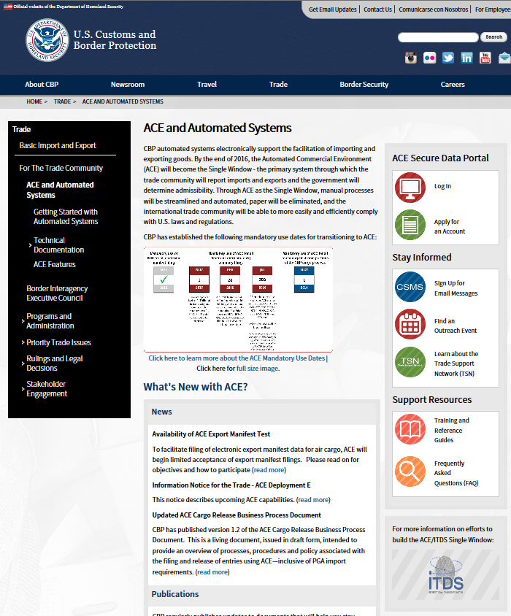
ACE on CBP.gov
Left Navigation:
  Getting started
  Technical Documentation (CATAIR, IGs, etc.)
  ACE Features
  (Detail on ACE capabilities)
Main Column:
  Updated with latest news/headlines
  Mandatory Dates
Gray box at bottom:
  What’s New with ACE?
  Links to publications
Right Navigation:
  ACE portal
  CSMS
  Outreach
  Training
  FAQs
2
4
1
3

Slide 14
Questions?
askace@cbp.dhs.gov

