Slide 1

An Update on ACE – Single Window
ACE Business Office and representatives from the Border Interagency Executive Council (BIEC) with presenters from 4 Partner Government Agencies (CPSC, FDA, APHIS, and EPA)

Slide 2

Welcome
Jane Sorensen, President
Chicago Customs Brokers and Forwarders Association
Linda Golf, Assistant Port Director, Trade
U.S. Customs and Border Protection, Chicago, IL

Slide 3
Border Interagency Executive Council
BIEC
Maria Luisa Boyce
Senior Advisor to the Commissioner for Private and Trade Sector Engagement, Office of Trade Relations, Office of the Commissioner, Customs and Border Protection
Captain Domenic J. Veneziano
Director, Division of Import Operations, U.S. Public Health Service, Food and Drug Administration

Slide 4
Partner Government Agencies
ACE/Single Window status update
Moderator:
Maria Luisa Boyce, Senior Advisor to the Commissioner for Private and Trade Sector Engagement, Office of Trade Relations, Office of the Commissioner, Customs and Border Protection
Speakers:
Carol Cave, Assistant Executive Director, Office of Import Surveillance, CPSC
Roy Chaudet, Office of Environmental Information (Via Web)
Estrella Calvo, Region 5 Enforcement Officer, EPA
Captain Domenic J. Veneziano, Director, Division of Import Operations, U.S. Public Health Service, Food and Drug Administration
Sean Blount, Quarantine Policy Analysis & Support, APHIS, USDA (Via Web)

Slide 5

CPSC PGA Message Set
& Certificate Registry Proposed
Alpha Pilot Overview
This presentation was prepared by CPSC staff, has not been reviewed or approved by, and may not reflect the views of, the Commission.

Slide 6

What is a Certificate?
A certification that a consumer product or other substance regulated by the Commission:
  Has been tested:
    Non-children’s products – a test of each product or a reasonable testing program
    Children’s products – testing conducted by a third party conformity assessment body (laboratory)
  Complies with all applicable safety rules, bans, standards, and regulations.

Slide 7
Required Certificate Types
General Conformity Certificate (GCC)
Non-children’s products only
Based on a test of each product or a reasonable testing program (14(a)(1) of the CPSA)
Must comply with 16 C.F.R. part 1110
Children’s Product Certificate (CPC)
Products intended primarily for children 12 years of age and younger
Based on testing conducted by a CPSC-accepted third party laboratory (14(a)(2) of the CPSA)
Requires periodic and material change testing
Must comply with 16 C.F.R. part 1110
http://www.cpsc.gov/Business--Manufacturing/Testing-Certification/Lab-Accreditation/Rules-Requiring-a-General-Certificate-of-Conformity/

Slide 8
Why Electronic Filing?
Expedite clearance
Identify high risk cargo for inspection
Conduct post-importation enforcement
Generate reports to assist with:
  Risk assessment
  Setting agency priorities and goals
Meet objectives of EO 13659, Streamlining the Export/Import Process for America’s Businesses.

Slide 9
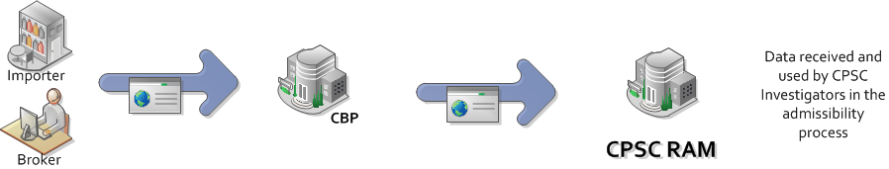
Full Certificate PGA Message Set
A way to file product certificates at time of entry filing
Full set of certificate data filed via the PGA Message Set with each entry line

Slide 10
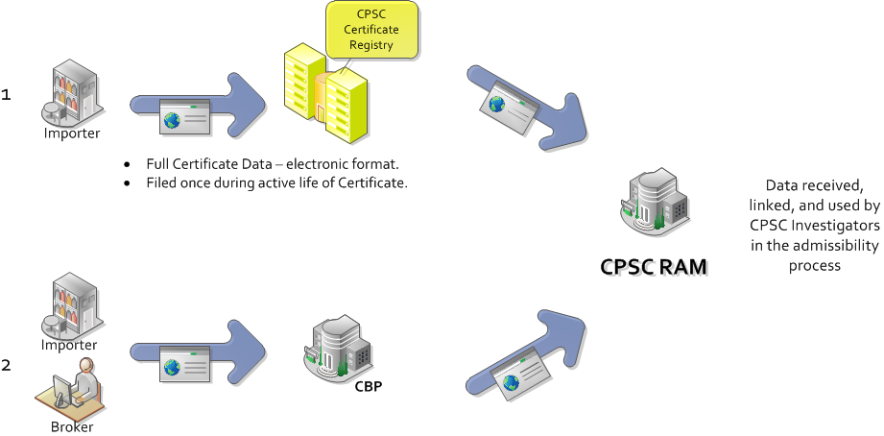
Reference Certificate PGA Message Set
A way to pre-file a product certificate in the CPSC Certificate Registry in advance of entry filing
Limits (but does not eliminate) the amount of data required to be filed via the PGA Message Set with each entry line

Slide 11

What is the e-Filing Alpha Pilot?
A two-pronged approach to electronic data collection of importer certificate data
  Full Certificate PGA Message Set or
  Reference Certificate PGA Message Set
  with CPSC Certificate Registry
A way to test implementation of e-filing in proposed 1110 rule
  Electronic submission of certificates at entry
  Using data elements from proposed 1110.11.

Slide 12

Alpha Pilot Goals
Inform the 1110 Rulemaking
Test the certificate data e-filing concept for Regulated Products
Identify and analyze the impact on industry, the government, and consumers
    Advancing the “single” window environment
    Impact on identification of noncompliant trade

Slide 13
Project Milestones
Federal Register Notice – With the Commission for a vote- Decisional scheduled August 12, 2015
Participant Recruitment – Summer/Fall ’15
Project Scope and Definition – Fall ’15
Go Live and Data Collection – Mid ’16

Slide 14

Next Steps
Stakeholder engagement:
  Trade Support Network working group
  Outreach events
  Others as identified
Recruit volunteers for the Pilot
Develop technical drafts for alpha pilot
  HTS mapping
  CATAIR

Slide 15

Q & A
www.cpsc.gov/cpc
www.cpsc.gov/gcc
www.cpsc.gov/certify
www.cpsc.gov/en/Business--Manufacturing/Testing-Certification/
www.cpsc.gov/testing (3rd party testing)
www.cpsc.gov/en/Business--Manufacturing/Testing-Certification/Third-Party-Testing/

Slide 16
EPA ACE Pilots:
Overview
July 30, 2015
Chicago, IL

Slide 17
Topics
Pilot Overview
Pilot Timing
Pesticide Notice of Arrivals
Questions

Slide 18





Pilot Overview
  Current pilots
    - Vehicle and Engine Declarations Imports
    Starting in ports of Long Beach, Newark, Norfolk (Vessel)
  Hazardous Waste Exports (Spent Lead Acid Batteries)
    Starting in ports of Hidalgo, Laredo (Truck)
  Pilot for Notice of Arrival for Pesticide Imports Test in CERT now!
    Starting in ports of Detroit, Port Huron, Chicago, Newark (Rail, Vessel)
  Planned for 2015
  Ozone Depleting Substances (ODS) Imports is being wrapped into the Toxic Substance Control Act (TSCA) program
    Expected capability in Fall
Notes:
EPA has two pilots in production:
1. Vehicles and Engines Declarations imports (formerly forms 3520-1 and 21)
Starting in the ports of Newark, Long Beach, and Norfolk
2. Hazardous Waste Exports
Starting in the Ports of Hildalgo and Laredo
The Pesticides Pilot is expected to go live in August.
Starting in the Ports of Detroit Port Huron, Chicago, and Newark.
Ozone Depleting Substances and TSCA pilot expected to start later this fall as part of CBP pilot rollout.
ALL PILOTS expected to rollout to ALL ports by Early-mid October.

Slide 19
Pilot Timing
Program | Guidance Available | CERT Testing Available | Production Filing Available
Imports
Vehicles & Engines | Now | Now | August 2015?
Pesticides | Now | Now | August 2015?
ODS/TSCA | Now | Summer | Fall
Exports | EEI | EEI | EEI
Hazardous Waste (spent lead acid batteries) | Now | Now | Now
Notes:
This is the pilot schedule
Guidance is available for all pilots.
Testing is currently available in CBP’s certification (CERT) environment NOW for all but TSCA which is expected later this fall.
Production filings can be made AFTER TESTING is completed in the CERT environment in late August.

Slide 20
The Import Process
Notice of Arrival
An importer desiring to import pesticides or devices into the United States shall submit to EPA a Notice of Arrival [EPA Form 3540-1] prior to the arrival of the shipment in the United States.

Slide 21
NOA Package for Registered Pesticides and Devices
NOA (EPA Form 3540-1) –Part 1 Complete, True, Accurate and contain an Original Signature
Copy of the label purported to be affixed to the pesticide or device (listed in box 5) that is to be distributed or sold to the US
Supplemental documentation supporting information listed in part 1 of the NOA (ie. invoices, packing lists, CBP Forms 3461, 7501, and/or 7512, etc.)
Return courier envelope and fully completed return airway bill

Slide 22
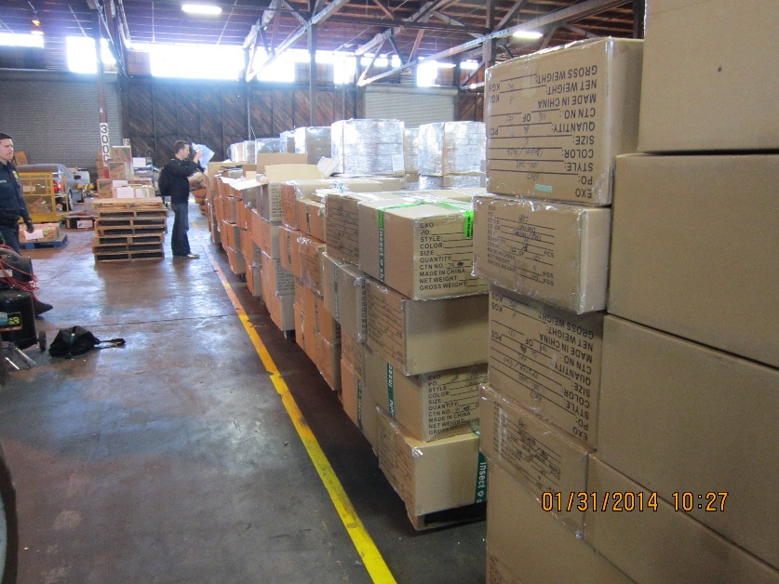

Pesticide Import Inspections
EPA Receives NOA
Coordinates w/ CBP
Conduct inspection at staging area
Notes:
Normal pesticide inspection at warehouse staging area

Slide 23


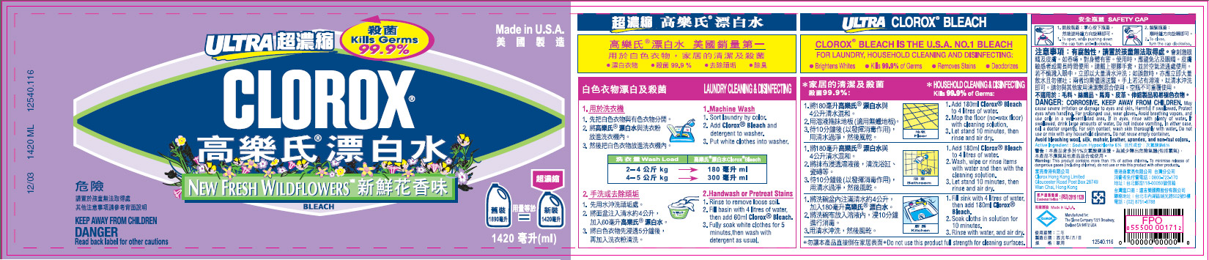
Illegal household pesticides
“Candy-colored” moth balls and insect chalk
Foreign labeled products
Notes:
Illegal import examples (the things that we rarely find in an import inspection … no NOA)
Para dichloro benzene or napthalene…which I believe is illegal in CA although not all states based on the States finding of carcinogenicity. The US Department of Health and Human Services (DHHS) has determined that 1,4-dichlorobenzene "may reasonably be anticipated to be a carcinogen’
Chalk - Exposure to Deltamethrin, the active ingredient, can cause vomiting, stomach pains, convulsions, tremors, coma and death due to respiratory failure.

Slide 24

Illegal household pesticides that target consumers within immigrant populations
Notes:
Region 2 “sting” operation in NYC Chinatown involving undercover CID agents
Coils may contain octachlorodipropyl ether and it’s burning likely exposes children and adults to some level of bis(chloromethyl)ether (BCME). BCME is formed from formaldehyde and hydrogen chloride. BCME is an extremely potent lung carcinogen. Their use is illegal in the United States
CAT BE UNEMPLOYED contains a pesticide called “brodifacoum,” a highly toxic anticoagulants. Rat poision. This illegal product has 60 times more concentrated active ingredient than the maximum allowable in any registered U.S. product!
It is highly lethal to children and pets.
Brodifacoum is not approved for direct consumer use; it may only be used by licensed professionals.

Slide 25
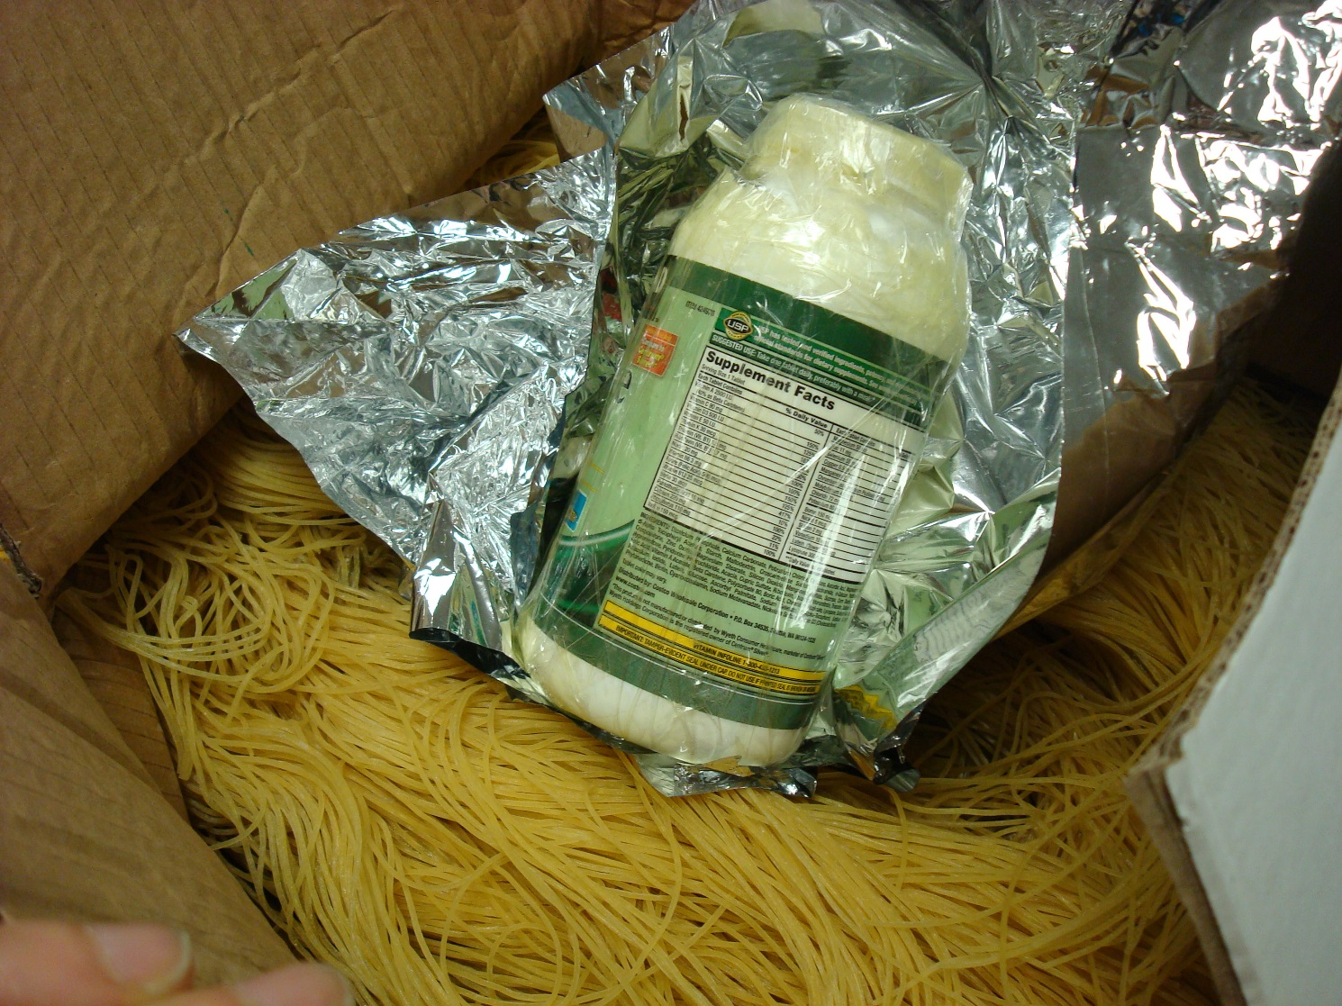

Pesticide Smuggling
Dichlorvos airmailed to LA from China in dried noodles
Notes:
Smell
Analyzed and found to contain dichlorvos
A category of pesticides known as “organophosphates,” used in agricultural settings and bug strips for household indoor uses. Over exposure affects the nervous system and neurotoxic effects including perspiration, vomiting, diarrhea, drowsiness, fatigue, headache, and at high concentrations, convulsions, and coma.

Slide 26
For More Information
Roy Chaudet
Office of Information Collection
Office of Environmental Information
U.S. Environmental Protection Agency
202-566-1703
chaudet.roy@epa.gov
Estrella Calvo
Region 5 Pesticides and Toxics Compliance Section
U.S. Environmental Protection Agency
(312) 353-8931
calvo.estrella@epa.gov

Slide 27

ACE/ITDS Implementation Update
U.S. Public Health Service
Director, Division of Import Operations
Notes:
27

Slide 28
What we have accomplished:
ACE/ITDS – FDA Implementation
  System Development and Implementation
    Interoperable Web Services (IWS) launched in August 2014 (Completed)
    PG Message Set (data elements, Supplemental Guide, Business Rules) (Complete)
    DIS Will not be integrated until later (FDA will utilize ITACS) (on-going)
    Unit Testing (on-going)
    CBP/FDA Testing (on-going)
    End to End Testing w/trade (on-going)
    FDA Pilot Tests Begins August 19, 2015
  Internal Outreach Activity
    Briefing FDA HQ and Field staff (Completed)
    Briefing field staff on pilot schedule, new IT changes, Operational expectations (Completed)
    CBP and FDA field staff (TBD)
  External Outreach Activity
    Webinar of ACE/ITDS March 24, 2015 http://www.cbp.gov/trade/stakeholder-engagement/webinars
    Port outreach scheduled by the BIEC EEC
    Supplemental Webinar (TBD)
  Administrative and Legal Requirements
    CBP NCAP FRN (being Finalized)
    FDA FRN (In Progress)
    MOU (Completed)

Slide 29
FDA Pilot Schedule
Date: August 19, 2015
Location: Baltimore, Philadelphia, Otay Mesa
Commodities: Drugs, Medical Products, Biologics
Data elements: Mandatory per Supplemental guide (Until November 1)
________________________________________________
Date: September 2, 2015
Location: 87 ports identified by CBP (12 Aug19 + 75 September 2)
Commodities: All with the exception of FOOD
Data elements: Mandatory per Supplemental guide (Until November 1)
________________________________________________
Date: September 16, 2015
Location: 207 ports identified by CBP (12 on 7/15 + 75 on 7/27 + 120 on 8/3)
Commodities: All with the exception of FOOD
Data elements: Mandatory per Supplemental guide (Until November 1)
________________________________________________
Date: September 30, 2015
Location: All ports
Commodities: All (Pending PN correction)
Data elements: Mandatory per Supplemental guide (Until November 1)

Slide 30
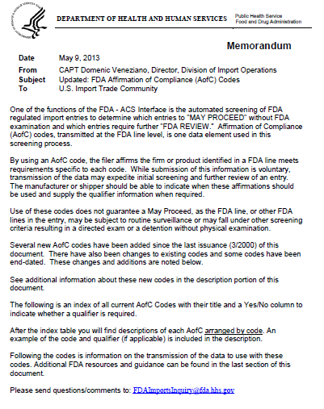
30

Slide 31
Drug Typing and Data Requirements – By Form
Form
Over the Counter
No Dosage Form
Investigational
Research and Development
Prescription
PG04 - Quantity = Dosage
PG07 – Brand/Trade Name - Mandatory
PG19 - Entity Roles – DEQ, DP, FD1, MF and at least 1 GD
PG23 - AofC – REG, DA (NDA or ANDA), NDC
PG04 - Quantity = Dosage
PG07 – Brand/Trade Name - Mandatory
PG19 - Entity Roles – DEQ, DP, FD1, MF and at least 1 GD
PG23 - AofC – REG, DA (NDA or ANDA)*, NDC
Pharmaceutical Necessities
PGO1 - IUC – 150.007
PG19 - Entity Roles – DP, FD1, MF , DEQ
Finished Dosage Form
Investigational
Research and Development
Prescription
Over the Counter
PGO1-IUC – 150.007
PG04 - Quantity = Total Amount
PG19-Entity Roles – MF , DP, FD1, DEQ
PG23 - AofC – REG, DA (NDA or ANDA), DLS
PGO1 - IUC – 150.007
PG04 - Quantity = Total Amount
PG19 - Entity Roles – DP, FD1, MF , DEQ
PG23 - AofC – REG, DA (NDA or ANDA)*, DLS
PGO1-IUC – 150.007
PG04 - Quantity = Total Amount
PG19 - Entity Roles – DP, FD1, MF , DEQ
PG23-AofC – REG, IND
PG04 - Quantity = Dosage
PG07 – Brand/Trade Name - Mandatory
PG19 - Entity Roles – DEQ, DP, FD1, MF and at least 1 GD
PG23 - AofC – REG, IND
PGO1-IUC – 080
PG04 - Quantity = Dosage
PG07 – Brand/Trade Name - Mandatory
PG19 - Entity Roles – DEQ, DP, FD1, MF and at least 1 GD
PG23 - AofC – REG
PG01 - IUC – 180.009
PG04 - Quantity = Total Amount
PG19 - Entity Roles – DP, FD1, MF , DEQ
PG23 - AofC – REG
* - See list of applicable Products

Slide 32
Table-top exercises for export and import processes:
On October 30, 2014, the Process Coordination Committee and the Risk Management Committee conducted two table top exercises for the BIEC that walked through the importation process of two separate products with multiple agency jurisdictions. The purpose of the exercise was to identify pain points and create a discussion of ways to streamline trade processes, facilitate lawful and compliant trade, and enhance compliance and enforcement efforts.
The two exercises identified six pain points, which needed to be evaluated. They include the need to:
  explore timely access to import data, (Completed)
  the potential utilization of unique facility and entity identifiers,
  the pivotal role of data quality and validation, (Completed)
  transparency on agencies targeting rules,
  enhanced communication on hold and release decision both to agencies and the trade, (Completed improvements still needed)
  and transparency between agencies on final disposition and enforcement actions.
These “Pain Points” have been evaluated and proposed solutions identified and currently in process

Slide 33
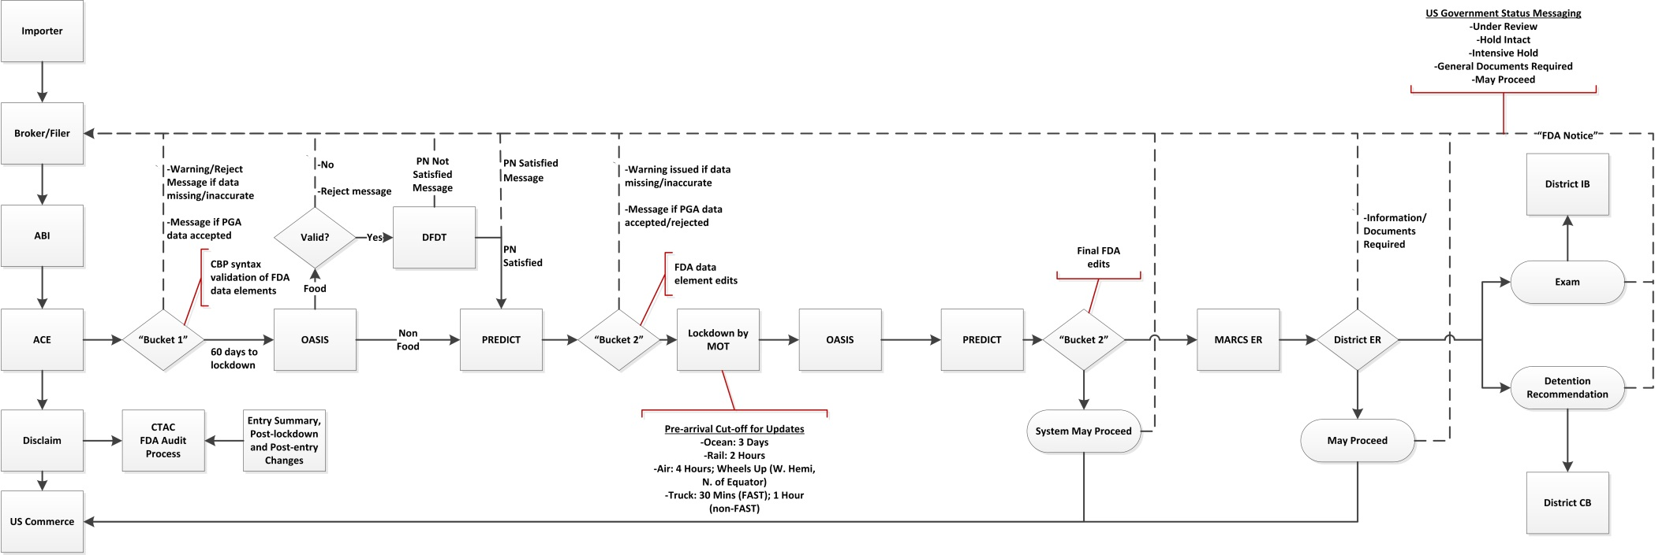
DRAFT
3-31-2015
The To Be

Slide 34


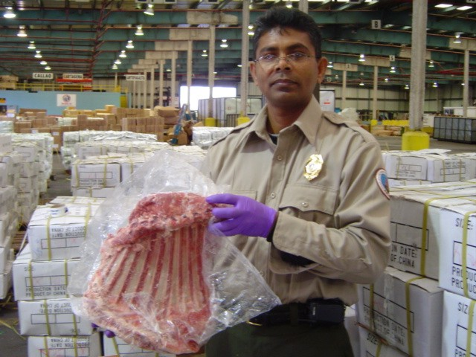
APHIS READINESS
Automated Commercial Environment
Sean Blount
US Department of Agriculture
Animal and Plant Health Inspection Service
Plant Protection and Quarantine
Notes:
Hello I am Sean Blount and I am with USDA-APHIS. I am here to discuss APHIS Readiness in the Automated Commercial Environment or ACE

Slide 35




APHIS ITDS Participants
Animal Care
Veterinary Services
Plant Protection
And Quarantine
Biotechnology
Regulatory Service
35
Notes:
The Animal and Plant Health Inspection Service is a multi-faceted Agency with a broad mission of protecting American agriculture and promoting its health. The agency is made of numerous programs but the following programs will serve as APHIS ITDS participants:
Animal Care
Veterinary Services
Plant Protection and Quarantine
Biotechnology Regulatory Service

Slide 36
APHIS ACE ITDS Goals
Goal
2
Goal
1
Goal
3
Electronically convert documents that accompany shipments to a message set
Supplement current Customs entry data
Populate inspection results systems and risk analysis
Notes:
As a result of the President’s Executive Order, APHIS is committed to accomplishing 3 goals:
Electronically convert documents that accompany shipments to a message set:
Licenses and Permits
Supporting documentation (invoices, packing list, and some VS forms) – Digital Image
Exception to this will be the government-to-government certificates
Supplement current Customs entry data:
Identifies the commodity at the granularity (Genus and Species)
Provides supplemental data that describes commodity’s intended use and types
Populate inspection results systems and risk analysis.
Provides analysts with an improved data set for evaluating risk
Allows for a feedback loop for importers to recognize where contamination is occurring

Slide 37

Data Collection Methods
PGA Message Set
Document Image System
(DIS)
Paper Collection
37
Notes:
The PGA Message Set - Establishes a single, harmonized set of information to be collected.
Document Image System (DIS) - Allows trade members to supply images of needed documents electronically during the cargo import and export processes.
Paper Collection – Government-to-Government certificates and some VS Forms.
***Lacey Act Note***
Message Set, Paper and electronically on the Lacey Act Web Governance website (APHIS LAWGS)
https://lawgs.aphis.usda.gov/lawgs/

Slide 38
APHIS ACE ITDS Timeline
Jun
Determining appropriate ports for Aphis Core piloting as well as continued outreach visits.
July
Collaboration with CBP ACE Business Office and trade on software development.
2015
Aug
Publish Federal Registry Notice (FRN) for APHIS Core and solicit pilot volunteers. Continue outreach.
Sept
Intense piloting and trouble shooting to ensure readiness for November 1st.
Oct
    Intense piloting and trouble shooting to ensure readiness for November 1^{st.}
38
Notes:
June – is also the target period to see the FRN published

Slide 39
Accomplishments and Updates
Accomplishments | Pending
PGA Message set document completed and posted on CBP.gov. http://www.cbp.gov/document/guidance/aphis-pga-message-set-adapted-data-element-record-layout Continue paper collection of certain VS forms and government-to-government certifications. APHIS documents to be collected through DIS have been posted on CBP.gov. ACE/ITDS page has been established on APHIS website. | Currently, reviewing high volume filers and ports to determine locations for piloting activities. Develop Q&A document for posting on the APHIS website. Outreach and webinars will continue at various ports around the country.
Notes:
Successfully completed and posted the PGA Message set document which can be found at http://www.cbp.gov/document/guidance/pga-message-set.
APHIS has received a waiver from the Office of Management and Budget to continue collection of certain forms and government-to-government certifications in a paper format.
Has updated our list of documents that will be used in the document imaging system (DIS). This list will be available at http://www.cbp.gov.
Will be creating an APHIS Q&A document to help address key questions you may have during this process. In addition, APHIS will also develop a new page to on the APHIS website that will continue to provide new and general information such as outreach and piloting. The Q&A document will be found on this page as well.
Currently, reviewing high volume filers and ports to determine locations to initiate piloting activities. Outreach visits and remote webinars are being scheduled to communicate with top filers.

Slide 40
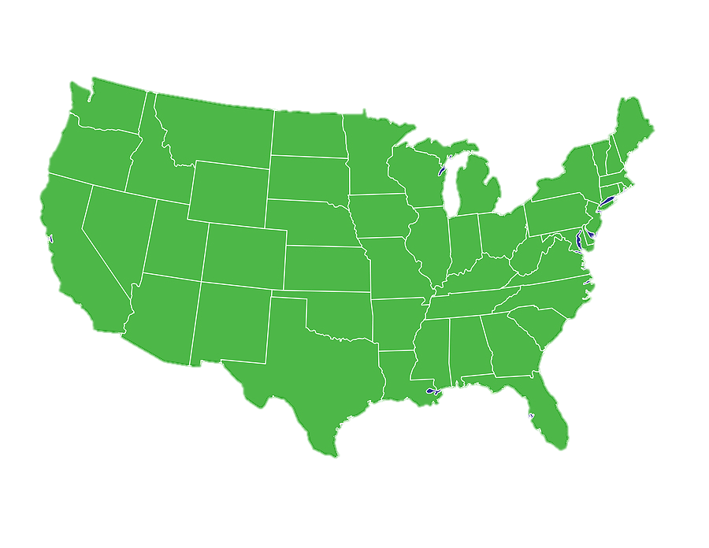
2015 Outreach Dates
Port/Area | Dates
LA/Long Beach, CA | Completed
Philadelphia, PA | Completed
Laredo, Hidalgo, TX | Completed
Buffalo, NY | Completed
Miami, FL | Completed
Detroit/Port Huron, MI | Completed
Sweetgrass, MT | Completed
Chicago, IL | 07/30/15
Champlain, NY | 08/04/15
New Jersey | 08/06/15
New York | 08/07/15
Otay Mesa/ San Diego | 08/18/15
Nogales, AZ | 08/20/15
**HQ Staff Support via Webinar**
Dates are subject to change
Notes:
Map indicates ports where outreach visits will occur whereas the highlighted dates to the right will be supported by webinars only.
Not listed is Seattle which was conducted on 5/28 – webinar
San Antonio, TX – August 14

Slide 41
Guidance and Support
Message Set Team
Collaborative Partners
Outreach & Pilots
The APHIS team has produced a technical guide
Committees & Subcommittees available to assist
Outreach meetings & webinars ongoing.
Pilot projects pending.
41
Notes:
As timelines and build-outs quickly approach, the following will serve as various support tools:
APHIS ITDS Message Set Team – produced a technical guide that can be found on CBP.gov
Advisory Boards – Committees and subcommittee such as the Customs Operations Advisory Council (COAC) and the Trade Support Network (TSN) will provide their expertise to assist in the transition and problem solving
Pilots/Outreach – Outreach meetings and webinars have begun and we are actively planning for pilots at various ports. Piloting is slated to commence in September 2015.

Slide 42

Lacey Act Pilot Project
Project Background
Participation Process
Projected pilot to start in July 2015
Submit PPQ 505 form via ACE
FRN to solicit volunteers
HTS Codes on
APHIS website
Guidance can be
found on CBP.gov.
Technical contact:
Pamela Bennett*
*Pamela.D.Bennett@aphis.usda.gov
42
Notes:
Background:
- Projected pilot to start in August 2015 (date TBD)
- APHIS will publish Federal Register Notice to solicit volunteers
- Guidance on PGA message set programing can be found on CBP ACE website.
Participation:
Required to submit Lacey Act Plant and Plant Products Declaration (PPQ 505) through ACE
Implementation schedule of the HTS Codes for commodities requiring declaration can be found APHIS Lacey Act website***
Lacey technical contact: Pamela.D.Bennett@aphis.usda.gov
***Note
APHIS is scheduled to include 20 new product types by August 06, 2015 . However, this will not be part of the July pilot .

Slide 43

Lacey Act Pilot Project
PORT LOCATIONS
  Chicago, IL
  Laredo, TX
  Los Angeles, CA
  Louisville, KY
  Detroit, MI
  Baltimore, MD
  Newark, NY
  Philadelphia, PA
  Otay Mesa/San Diego, CA
43
Notes:
Background:
- Projected pilot to start in July 2015 (date TBD)

Slide 44
What does this mean for APHIS?
Expedites the review and release of cargo
Assists with risk analysis and provides feedback
Improvement of internal electronic systems
Allows for view of shipments at the granular level
44
Notes:
Expedites the review and release of cargo.
Allows for APHIS to view shipments at the granular level (genus and species).
Assist with risk analysis and provide a feedback loop with pests and animal disease concerns
APHIS is currently updating their internal electronic systems to make the application process a better experience for our stakeholders.

Slide 45
What changes will industry see?
Customs brokers must learn to operate in the new “Single Window” environment
Software vendors must adhere to CBP and APHIS guidelines
CBP & APHIS working with importers to ensure compliance by Nov. 1st
Impact to trade industry mainly at the filer level
Impact
Procedure
Programming
Support
45
Notes:
Will impact trade at the filer level with inputting key data fields used to replace most supporting documents
Customs brokers will want to review there old business approach and begin to align it with the in the Single Window environment
Software vendors who support importers are building the needed software using the APHIS implementation guide
CBP and APHIS are working with the biggest importers to make sure they are able to interface with the Single Window beginning November 1st

Slide 46


Cindy Walters
APHIS ACE ITDS Liaison
Office: 301-851-2273 Cindy.L.Walters@aphis.usda.gov
46

Slide 47
2015 Border Interagency Executive Council (BIEC)
ACE/Single Window Outreach with partner Government Agencies (PGA)
10 Minute Break

Slide 48
ACE/Single Window Implementation
Moderator: Linda Golf, Assistant Port Director Trade, Area Port of Chicago
Speakers:
Ken Muellner, ACE Ambassador, CBP
Vincent Annunziato, Director, ABO, Office of International Trade, CBP
Lisa Gelsomino, Avalon Risk Management
Celeste Catano, KeWill
Susie Hoeger, Abbott Laboratories
Merit Tremper, Merit Trade Consulting Services

Slide 49
Automated
Commercial
Environment (ACE)
Program Status
ACE Business Office
U.S. Customs and Border Protection
July 2015

Slide 50
Customs Support Network Ken Muellner, ACE Ambassador, CBP
Key ACE Transition Dates Vincent Annunziato, Director, ABO, CBP
ACE Progress
  ACE Remaining Deployments
  Functionality to Support November 1
Partner Government Agencies Overview
  PGA Readiness for November 1
  PGA Forms for November 1
  PGA Messaging
New for Imports
Key Dates to Support November 1
Resources and Support

Slide 51
Field Readiness Coordinators
Support the ACE Ambassadors in their outreach efforts to CBP and the trade community.
Serve as a liaison between OT/ABO, OFO Cargo and Conveyance Security, Field Offices, and ACE Ambassadors.
Serve as an ACE POC for OFO and OT offices, as needed.

Slide 52
ACE Ambassadors
Provide insight and subject matter expertise critical to the successful transition to ACE for CBP and trade stakeholders within their area of responsibility.
Serve as an ACE advocate and point of contact for the field/port office or the CEE, and for the trade community.
Work with ABO to obtain current ACE information and materials (e.g., presentations) for distribution.
Distribute materials, coordinate briefings and presentations, and conduct outreach efforts with CBP personnel and the trade community, as needed.

Slide 53
ACE Entry Summaries (June 2015)
ACE Entry Summaries filed (June 2015)
National: 1,728,784 ES; 60.4% of all ES; 2,394 Filers (1,051 ACE)
3901: 70886 ES; 53.6% of their ES; 1026 Filers (535 ACE)
3902: 48 ES; 21.7% of their ES; 11 Filers (6 ACE)
3908: 3 ES; 75% of their ES; 3 Filers (3 ACE)
3909: 720 ES; 69.8% of their ES; 45 Filers (23 ACE)
DFO 39:
  286,723 ES 72.7% of total ES filed
  4854 Filers (2522 ACE)

Slide 54
Post Summary Corrections (June 2015)
National: 9,052 ES; 162 Filers
3901: 160 PSC; 36 Filers
ACE Cargo Release (June 2015)
National: 58,846 ACE Cargo Releases; 841 Filers
3901: 1868 ACE Cargo Release Entries; 36 Filers
3909: 1 ACE Cargo Release Entry; 1 Filer

Slide 55
ACE Cargo Release Business Transformation Process Document
James Swanson, Director
Cargo Security and Control, Cargo and Conveyance Security,
Office of Field Relations, U.S. Customs and Border Protection http://www.cbp.gov/document/guidance/ace-cargo-release-business-transformation-process-document
Send Comments on the Document to the Following Address:
SINGLE-WINDOW-INITIATIVE@cbp.dhs.gov

Slide 56
ACE Update
Vincent Annunziato, Director, ACE Business Office, Office of International Trade, CBP

Slide 57
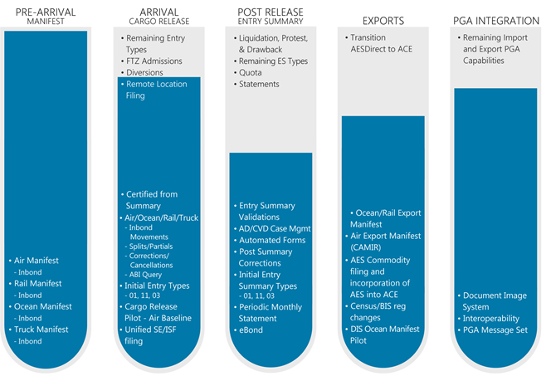
ACE Progress
Notes:
Now let’s talk about specific functionality that has been delivered in ACE and is still to-be-built.
As we mentioned, we’ve delivered 4 of 7 primary deployments on schedule. Here are the details of what we’ve deployed thus far.
100% of Import Manifest functionality is now in ACE.
All electronic truck, ocean, rail and air manifests must already be filed in ACE.
More than 80% of core Cargo Release processing capabilities have been delivered in ACE.
We’ve expanded ACE Cargo Release to include AD/CVD entries.
As of April, ACE entries can now be filed at all CBP ports, in all modes.
Benefits of ACE Cargo Release include:
Eliminate submitting paper Form 3461 (entry document)
File shipment data prior to carrier notifying CBP of departure
Receive status updates prior to cargo arrival
No need to submit corrections through a paper form
Make corrections to cargo entry data electronically
More than 60% of Post Release capabilities are in ACE.
Entry types 01, 03, and 11 can be filed in ACE, representing almost 99% of entry summaries filed.
Entry summary validations, identified as a top priority by brokers, have been significantly expanded in ACE.
Benefits of ACE Entry Summary filing include:
Eliminate submitting Form 7501 (paper entry summaries)
Request ACE cargo entry certification from ACE entry summary
File Antidumping/Countervailing Duty entry summaries (Entry Type 03) using Remote Location Filing (RLF)
Process Census warning and overrides electronically through ACE
Transmit Post Summary Corrections (PSC) electronically, receive refunds quicker
Gain access to an expanded AD/CVD query
Obtain more information from the ACE Entry Summary query
More than 70% of export processing functionality has been deployed in ACE.
The Automated Export System (AES) is now part of the ACE platform.
Pending the issuance of a Federal Register Notice, a pilot will be initiated for electronic air, ocean and rail export manifest capabilities.
We plan to deliver exporter accounts and reports in ACE in June, and are working to transition AES Direct to ACE.
More than 80% of Single Window integration capabilities have been deployed in ACE.
We’ve delivered the core technical foundation for the Partner Government Agencies (PGAs), and are now focused on integrating PGAs in ACE.
We have five PGA pilots underway.
In addition to CBP, we’ve identified 15 PGAs with requirements that must be incorporated into ACE in order to meet the Nov 1. deadline. We are actively working with them to ensure readiness.

Slide 58
PGA Update, Messaging
Advanced Messaging
Buckets | Hold Types | Release Messaging
Agencies with Hold authority and Port Presence | Intensives – Bucket one: sets the intensive and releases | Only CBP will issue a release
Agencies with Hold authority, but no Port Presence | Intensives – Bucket two: CBP sets the hold on “behalf” of another agency | PGAs will issue May Proceeds for any holds set by an agency
Agencies that use Hold intact | Hold In Tacts – set specifically by PGA: Do not affect release Are issued at the line level of the entry | 1USG – sum total of all holds: (Intensive, Doc Review and Hold Intact) must be resolved to issue Issued Post Arrival release

Slide 59
Deployment E
Deployment E – June 27, 2015
Exporter Accounts: Can be created for: Existing ACE Portal Accounts (for existing EINs, i.e., those currently matching Importer of Record (IR) numbers in the Company’s Importer Account) New EINS (not matching IR numbers in the Importer Account) New ACE Portal Accounts. Exporter Account Reports: Facilitate access to ACE Trade Export Reports that include export commodity data (current year and five years of historical data).
Deployment E - July 11, 2015
Quota Validations Until November 1, 2015, entries that are subject to quota must be filed in the Automated Commercial System (ACS). Effective July 11th, a new system validation automatically rejects ACE Cargo Release entries that are subject to quota and entered without the correct entry type. Mail, Passenger (hand-carried), and Pipeline Entry ACE will process entries from the mail, passenger, and pipeline modes of transportation types 50, 60, and 70, respectively.
Notes:
CBP.gov/ACE/What’s New with ACE
Export Accounts: An exporter account will be required to access the ACE AESDirect filing portal once it is available later this year.

Slide 60
Deployment E
Deployment E – August 8, 2015
Remote Location Filing (RLF) for ACE Entry Summaries Certified for ACE Cargo Release ACE Entry Summaries certified for ACE Cargo Release. DOCS Required must be submitted to CBP via the Document Image System (DIS). Filing RLF Transactions that are certified for ACE Cargo Release will allow you to file single transaction bonds electronically via ACE eBond. Single Pay Option for ACE Entry Summaries Eliminates the Header Single Pay Claim Restriction. Trade will be able to select Single Pay or Statements as options for the pay basis for ACE Summaries. Refactored Entry Summary Types 01, 03, and 11 in new ACE Platform Seamless for filers. CBP encourages testing in CERT prior to deployment. Entry Type 52, Entry Summary Types 51 & 52 Entry type 52 (Government – Dutiable). Entry summary types 51 (Defense Contract Administration Service Region (DCASR) and 52.
CERT Testing
On May 20th, much of the code needed for the November 1, 2015 mandatory date was deployed to the Certification environment for testing by all trade filers. CBP strongly recommends trade filers work with their Client Reps to test new and existing entry and entry summary capabilities (including entry/entry summary types 01, 03, and 11) . Implementation Guides are posted to CBP.gov/ACE.Mail.
Notes:
CBP.gov/ACE/What’s New with ACE

Slide 61
PGA Readiness for November 1
CBP and 15 PGAs identified with requirements that must be incorporated into ACE in order to meet the November 1 date for mandatory filing of entry and entry summaries
Department | Agency
Department of Agriculture | Agricultural Marketing Service (AMS) Food Safety and Inspection Service (FSIS) Animal and Plant Health Inspection Service (APHIS)
Department of Commerce | National Marine Fisheries Service (NMFS) Enforcement and Compliance (E&C)
Department of Defense | Defense Contracts Management Agency (DCMA)
Department of Health & Human Services | Centers for Disease Control and Prevention (CDC) Food and Drug Administration (FDA)
Department of Homeland Security | U.S. Customs and Border Protection (CBP)
Department of the Interior | Fish and Wildlife Service (FWS)
Department of Justice | Bureau of Alcohol, Tobacco, Firearms and Explosives (ATF) Drug Enforcement Administration (DEA)
Department of State | Directorate of Defense Trade Controls (DDTC)
Department of Transportation | National Highway Traffic Safety Administration (NHTSA)
Department of Treasury | Alcohol and Tobacco Tax and Trade (TTB)
Independent Agencies | Environmental Protection Agency (EPA)

Slide 62
Partner Government Agencies Pilots
PGA Data
Rollout of PGA Capabilities
Lists of all forms that must be submitted in ACE come Nov 1 available at www.cbp.gov/ace
Identified mechanisms for submitting data:
  PGA Message Set (EDI Transmission)
  Document Image
  System (DIS)
PGAs will support series of pilots beginning in July 2015
  12 ports involved in initial rollout
  Support new processes for receiving and processing PGA data
Phase 1
12 Ports
Phase 2
Phase 3
Phase 4
All Ports
Baltimore
Chicago
Detroit
Port Huron
JFK Airport
Newark
LA
Long Beach
Laredo
Louisville
Otay Mesa
Philadelphia

Slide 63
Stay up to date on ACE
Outreach
Training
Email Alerts (CSMS)
Stay up to date on community events and webinars.
www.cbp.gov/aceoutreach
Find user guides and online courses on the ACE Portal and system functions.
www.cbp.gov/trade/ace/training-and-reference-guides
Receive automatic updates on ACE on: system outages, new capabilities, technical documentation and more.
www.apps.cbp.gov/csms/csms
FAQs
Answers to some of our most frequent questions on: ACE Portal, manifest filings, cargo release, and more.
www.cbp.gov/trade/automated/ace-faq
www.cbp.gov/ace

Slide 64
ACE Support Resources
Technical
For technical support with the ACE system, functions or data, please contact:
General
For non-technical inquiries please submit questions to:
Electronic Data Interchange (EDI)
For issues concerning submitting data to ACE through EDI, please contact your assigned client representative. If you don’t have one please contact:
ace.support@cbp.dhs.gov
(866) 530-4172
askace@cbp.dhs.gov
(571) 468-5500

Slide 65
Questions?
askace@cbp.dhs.gov
May 1, 2015 Mandated use of ACE for all electronic manifest filings. | November 1, 2015 Mandated use of ACE for electronic Cargo Release and associated Entry Summary. | October 1, 2016 Mandated use of ACE for all remaining electronic portions of the CBP cargo process.

Slide 66
Chicago Brokers, ACE Experience; ABI; e-Bonds; and COAC recommendations
Lisa Gelsomino, Avalon Risk Management
Celeste Catano, Kewill
Susie Hoeger, Abbott Laboratories
Merit Tremper, Merit Trade Consulting Services

Slide 67


Slide 68




Introductions
Celeste Catano, Senior Global Strategist, Kewill
14th Term COAC, TSN Trade Ambassador and TLC Leadership
  Industry Thought Leader, COAC 1USG Subcommittee
  Email: celeste.catano@kewill.com; Phone: 866-649-1900
Susie Hoeger, Director of Global Trade Compliance & Policy – Abbott
13th and 14th Term COAC, AAEI Board Member, NAFTZ
Co-Chair, 1USG Subcommittee; Co-Chair, FDA Working Group
Email: susie.hoeger@abbot.com; Phone: 847 935 2355
Lisa Gelsomino, President/CEO – Avalon Risk Management
14th Term COAC, TSN eBond/Surety Subcommittee, ITSA/CSEC, NCBFAA
Email: lgelsomino@avalonrisk.com; Phone: 847-700-8192
Avalon eBond Page: http://www.avalonrisk.com/ebond.html
CBP eBond Page | http://www.cbp.gov/trade/trade-community/programs-administration/bonds/ebond
CSEC Q&A | http://www.ncbfaa.org/Scripts/4Disapi.dll/userfiles/uploads/Final_CSEC_eBond_FAQ_101014.pdf
ABI eSTB IG Bond/eBond CATAIR | http://www.ncbfaa.org/Scripts/4Disapi.dll/userfiles/uploads/3098_001.pdf
Revenue Division | http://www.cbp.gov/trade/bonds

Slide 69


ACE Timeline – 2015
Aug. 19, 2015
PGA Pilot Rollout
PGA Document
PGA Pilots
Jan. 3, 2015
eBond Deployment
    CBP eBond Page
-Continuous Bonds
-ISF Singles
-STBs for ACE Cargo Release
July 11, 2015
Mail, Passenger, Pipeline (50, 60, 70) Modes of Transportation
Nov 1, 2015
June 7, 2015
Air Manifest in ACE
-Lessons Learned
-More time for testing
-National contingency plan
Aug. 8, 2015
RLF and Entry Type 52
CSMS# 15-000438 - Updated ACE Deployment E Information Notice and ACE Maintenance Window Information
4

Slide 70
Race for ACE
Continuous Bonds (CB)
  5 business days
  Over 3,283 hours
eBond
  5 to 30 seconds
  38 to 288 hours
Transaction | Count
eBonds Filed Total | 88,166
eCBs Filed Total | 38,520
eISF Singles | 41,561
eSTBs Matched | 1,851
eSTB Void | 4,044
Elimination of Name/Address Riders
“ABI Filers can update Importer/Consignee File name and address data by placing a “U” in the Update Action Code data field of T1 input record.”

Slide 71
Frozen Importers
Policies and Procedures - CBP Form 5106
Importer records may be “frozen” per 19 CFR 24.5
A “frozen” importer record may be changed only if an authorized individual makes the request.
Frozen changes can only be transmitted by the Revenue Division Bond Team (RDBT). CBP Form 5106, signed by an authorized signer, to cbp.bondquestions@dhs.gov.
Returned Mail Policy
New 5106 submit comments per Federal Register Notice issued on July 27, 2015 (30 day notice period)

Slide 72
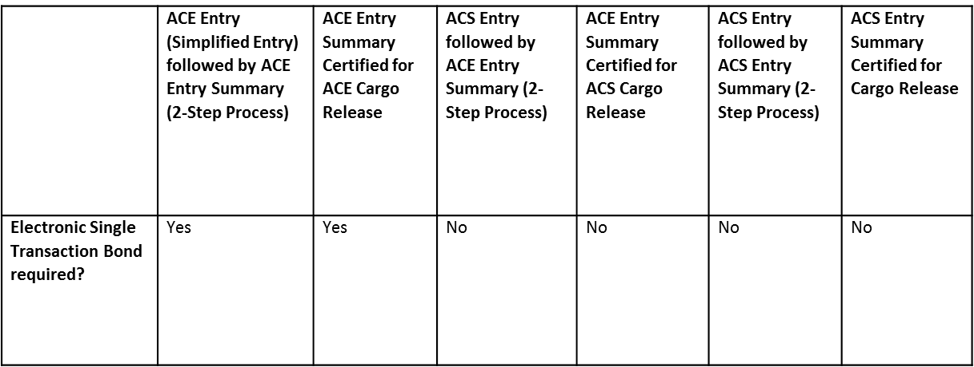
eBond Rules
Email STB
ACE_STB@cbp.dhs.gov
CSMS# 10-000060
CSMS# 15-000113 - Clarification on Electronic Single Transaction Bond usage in ACE eBond
eBond Required: For ACE Entries followed by ACE Entry Summaries, or ACE Entry Summaries certified for ACE Cargo Release, where an STB is used, an eBond will be required effective January 3, 2015. ACE will implement validations on these inbound transactions where, if a bond is referenced on a transaction, and no bond is found on file in ACE, that transaction will be rejected. Only Entry Types 01, 03 and 11 processed in ACE at this time.
eBond Not Required: For all other STB scenarios listed above, eBond will not be required. Paper processing of these STBs will continue as they do today. Due to the eventual retirement of ACS processing for Entries and Entry Summaries, the same eBond STB validations in place for ACE filed transactions will not be deployed to ACS. As such, we will not perform the system validations to ensure an STB is on file for these Entry/Entry Summaries. For this reason, operations will remain status quo until the November 2015 deadline

Slide 73
ABI Vendors
ABI Readiness
  http://www.cbp.gov/document/guidance/abi-software-vendors-list
  100% ACE Entry Summary (ES)
  60% ACE Cargo Release (CR)
  30% Digital Imaging System (DIS)
eBond Integration
  Per Avalon survey, 80% of CHBs want to integrate
  21 ABI vendors indicated they would integrate
  4 ABI Vendors testing ebond integration
  Self filers already integrated or ready by 7/1/15

Slide 74
eBond ABI Workflow
Bond-Entry Match Criteria
  Entry #
  Importer #
  Entry Type (01 vs. 03)
  Bond Amount Customs Directive 099 3510-004
Entries with no Bond Match
  “Hard Rejection” from CBP
  Not a Warning
ACE Cargo Release entered into ABI System, held while eBond sent to Surety
Surety Reviews eBond Data and Transmits to CBP
Broker Receives Bond on File Message; ABI transmits ACE Cargo Release to CBP
CBP matches eBond to Entry; Perfect Match!
Everyone Receives More Messaging

Slide 75
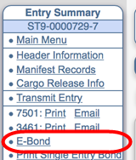
eBond ABI Integration
Complete ACE Cargo Release; or ACE Entry Summary certified for ACE Cargo Release
Option to request e-Bond within ABI system
Menu will vary by ABI Vendor
ABI Vendors Should Hold Entry in Queue as Best Practice

Slide 76
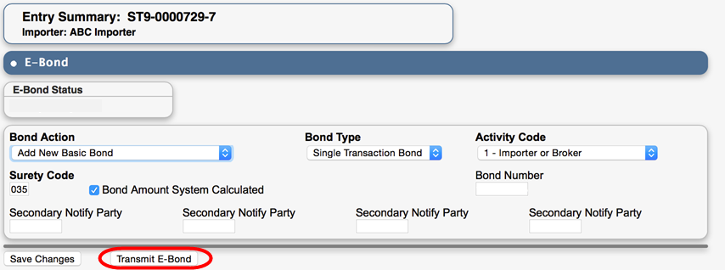
eBond ABI Integration
User navigates to eBond Page in ABI Software
Relevant entry information will pre-populate based on standard Data Elements for the trade
Transmit eBond sends data request to surety

Slide 77
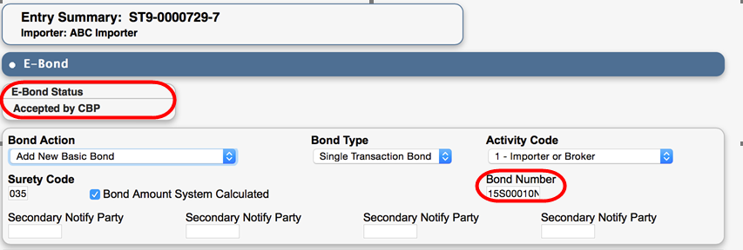
eBond ABI Integration
Once eBond filed with CBP, surety sends ABI message with CBP status and Bond Number
ABI Vendor should automatically transmit entry to secure Match with eBond on file in ACE
Secondary Notify Party – ABI Routing Code (Filer + Port Code + Branch) Provide to Surety
http://www.avalonrisk.com/questnewsletter/special-quest/2015-2-20-%20SNP%20Code/eBond%20Secondary%20Notified%20Parties%20FAQ.pdf

Slide 78
One U.S. Government at the Border Subcommittee
CBP: Cynthia Whittenburg, Executive Director
Trade Policy & Programs, Office of International Trade
Deborah Augustin, Acting Executive Director
ACE Business Office, Office of International Trade
Thomas Mills, Deputy Executive Director, Cargo Systems Program Directorate, Office of Information and Technology
CPSC: Carol Cave, Assistant Executive Director, Office of Import Surveillance, U.S. Consumer Product Safety Commission
FDA: Domenic Veneziano, Captain, U.S. Public Health Service, Director, Division of Import Operations, Food and Drug Administration
COAC: Susie Hoeger, Member
Scott Boyer, Member
Amy Magnus, Member

Slide 79
Single Window Recommendations
The COAC strongly supports the February 19, 2014 President Obama’s Executive Order 13659: Streamlining the Export/Import Process for America’s Businesses, specifically through the Automated Commercial Environment (ACE) through strategic discussions, communication and metrics. This will help with the validation of Single Window and ACE implementation
1. ACE Entry Summary: For Entry Summaries that are fully functional in ACE today (types 01, 03, and 11), COAC recommends that CBP maintain the mandatory filing date of November 1. If filers are unable to file these ACE Entry Summary types on November 1 due to unforeseen trade or government systems issues, CBP should allow for a defined informed compliance period, similar to how ISF was implemented. CBP should evaluate the reason the filer is unable to file and require an action plan from the filer that describes how they will become compliant, and hold them accountable for meeting the plan. CBP should also allow for a defined informed compliance period for filing Entry Summary for those entries that cannot currently be filed in ACE (for example, Lacey and consolidated summaries with multiple consignees).

Slide 80
Single Window Recommendations
ACE Cargo Release (without PGAs or with “DIS only” PGAs): COAC recommends that CBP review the ACE Cargo Release adoption rates, development and deployment issues, and other factors as the November 1 date approaches. We recommend that CBP continue to message November 1 as the mandatory filing date for ACE Cargo Release, but implement a “Phased Adoption” schedule, with COAC’s input and industry acceptance, for the complete implementation of ACE Cargo Release to ensure adequate time for programming, testing, training, and deployment. To encourage timely implementation, in consultation with COAC, CBP should provide incentives to filers who are able to meet the November 1 date. For those unable to file, CBP should analyze the filers who have shown a genuine effort to deploy ACE Cargo Release but due to various issues are unable to fully comply. CBP should allow those filers to continue filing ACS Release with ACE Entry Summary under a defined informed compliance period during which CBP will continue to work with those filers through their deployment and exercise enforcement discretion. Those filers who have shown minimal or no attempt to file ACE Cargo Release by November 1 should be held to a more aggressive action plan and be held accountable if minimal or no effort is apparent.

Slide 81
Single Window Recommendations
ACE Cargo Release (with PGA message sets): COAC recommends that CBP, the BIEC and ITDS adjust the November 1 requirement to file ACE Cargo Release with PGAs by ninety (90) days with periodic reassessment to ensure that all pilots have been concluded, issues have been resolved, and the related PGA message sets are fully defined and locked down. Given the complexity of the PGA aspects of ACE Cargo Release, CBP should provide adequate time for the trade to program, test, train, and deploy after the conclusion of the pilots.

Slide 82
Single Window Recommendations
Quota Entries: COAC recommends that CBP delay the ACE go-live date for quota Entry Summary and Cargo Release until January 1, 2016.
Document Imaging System (DIS): COAC recommends that CBP conduct testing, prior to November 1, to ensure that the Document Imaging System can handle large volumes of documents submitted via ABI DIS. In the event DIS is unable to handle the volume on November 1, COAC recommends that CBP consider alternate options to DIS, such as posting documents to the ACE portal as done today and/or allowing filers to email documents in accordance with a standard protocol, and advise the trade of those contingency plans.
Trade Briefings: COAC recommends that CBP provide COAC and the trade with bi-weekly briefings and status reports, including metrics, on each of the PGA’s ACE pilots and general readiness for the mandatory filing date, as well as CBP’s future vision for ACE.

Slide 83
Single Window Recommendations
National Guidelines and Escalation: To ensure a common and consistent approach by all ports, COAC recommends that CBP issue national guidelines for dealing with major issues (such as cargo release at terminals and ports) or processing challenges that arise in ACE implementation, including defined escalation paths and the assignment of adequate field, port, and technical resources. CBP should continue the “war room” approach, with sufficient allocation of resources to close all major issues. CBP should clarify the role of field, port, and technical staff, as well as the ABI Client Representatives, in terms of assisting the trade when ACE implementation issues arise. CBP should also issue clear, detailed CSMS messages as soon as possible when ACE implementation issues are identified. If necessary and to ensure port consistency, CBP should provide national guidance on and headquarters review of the issuance of any liquidated damages due to technical difficulties.

Slide 84
Single Window Recommendations
Communication to the Trade: COAC recommends that, to the greatest extent possible, CBP and the PGAs leverage the BIEC and ITDS to provide more targeted and less technical communication of business rules and processes (including policy), software changes, and new requirements to all of trade, including importers, filers, and software vendors, so their respective business processes can be modified accordingly in advance of the mandatory filing date. CBP and the PGAs should not assume that software providers are pushing out this information to their customers, or that highly technical information such as the CATAIR is easily understood by all members of the trade. CBP should also continue to extend communication to other trade members, such as CFS stations and terminals, where paper forms may be required for release, such as non-AMS facilities.
Leveraging BIEC/ITDS: We recommend that CBP leverage the BIEC and ITDS in the oversight of the PGA ACE pilots with the intent of preventing data creep and maintaining alignment with the PGA’s current regulatory authority in the development of the PGA message sets, to ensure predictability of operations for the trade.

Slide 85
2015 The year of ACE
The Good
The Bad
The Ugly
By: Merit Temper
Merit Trade Services
Ace extrondaire
ACE Filing Experiences
Disclaimer: These views are not those of the Chicago Brokers and Forwarders Association nor of the National Customs Brokers and Forwarders Association of American. Nor do they represent the individual views of the person standing before you.
85

Slide 86

2015 The year of ACE
ACE Filing Experiences

Slide 87


ACE lets get started
93 Days until November 1, 2015
ACE Portal
ACE Business Rules
  Cargo Release Version 1.2
  Entry Summary Version 4
ACE Entry Summary
  Unified Filing (ISF and Cargo Release
  with Entry Summary)
ACE Cargo Release
  Full release info
  Minimal amount needed to receive release.
  http://www.cbp.gov/document/guidance/ace-cargo-release-business-transformation-process-document

Slide 88

What caN we do and what cant we do ?
Entry Types available as of today for Entry Summary and Cargo Release
PGA’s that are available for your Cargo Release
Type 01, 03 and 11
What can we file on Entry Summary?
Everything except Lacey Act (Coming August 19th to an entry summary near you).
None
There are Pilot programs for EPA and FSIS but you have to sign up to participate in those
When is everything else going to be ready on the PGA’s?

Slide 89

Current Benefits of Filing Entry Data Through ACE
Benefits of ACE Cargo Release Entry:
Eliminate submitting paper Form 3461 (entry document) File shipment data prior to carrier notifying CBP of departure Receive status updates prior to cargo arrival No need to submit corrections through a paper form Make corrections to cargo entry data electronically
Benefits of ACE Entry Summary:
Eliminate submitting Form 7501 (paper entry summaries) Request ACE cargo entry certification from ACE entry summary File Antidumping/Countervailing Duty entry summaries (Entry Type 03) using Remote Location Filing (RLF) Process Census warning and overrides electronically through ACE Transmit Post Summary Corrections (PSC) electronically, receive refunds quicker Gain access to an expanded AD/CVD query Obtain more information from the ACE Entry Summary query

Slide 90
CBP and 15 PGAs identified with requirements that must be incorporated into ACE in order to meet the November 1 date for mandatory filing of entry and entry summaries
Department | Agency
Department of Agriculture | Agricultural Marketing Service (AMS) Food Safety and Inspection Service (FSIS) Animal and Plant Health Inspection Service (APHIS)
Department of Commerce | National Marine Fisheries Service (NMFS) Enforcement and Compliance (E&C)
Department of Defense | Defense Contracts Management Agency (DCMA)
Department of Health & Human Services | Centers for Disease Control and Prevention (CDC) Food and Drug Administration (FDA)
Department of Homeland Security | U.S. Customs and Border Protection (CBP)
Department of the Interior | Fish and Wildlife Service (FWS)
Department of Justice | Bureau of Alcohol, Tobacco, Firearms and Explosives (ATF) Drug Enforcement Administration (DEA)
Department of State | Directorate of Defense Trade Controls (DDTC)
Department of Transportation | National Highway Traffic Safety Administration (NHTSA)
Department of Treasury | Alcohol and Tobacco Tax and Trade (TTB)
Independent Agencies | Environmental Protection Agency (EPA)

Slide 91

Staff TRainING
How to read the ABI Messages that come back
How to review and respond to Census Warnings
How to Transmit Post Summary Corrections
When to use the DIS in Your Program, The ACE Portal or CEE’s E-mail. Never send paper documents

Slide 92

2015 The year of ACE
Lets talk about our experiences with ACE so far

Slide 93

2015 The year of ACE

