Slide 1




™
Ins and Outs of ATA Carnets!
Presented by: Amanda Barlow
For CCBFA
August 17, 2023

Slide 2





™
™
What do these items have in common?

Slide 3

ATA Carnet
  The Passport for Goods
  International development tool
  International customs document
  Allows temporary entry of items, duty-free and tax-free, whether shipped or hand-carried
  Established by international ATA convention

Slide 4
™
™
Who Manages the ATA Carnet?
International level
World Customs Organization (WCO)
International Chamber of Commerce (ICC)
National Guaranteeing Organizations (NGOs)
In the U.S.
US Council for International Business (USCIB)
US Customs and Border Protection (US CBP)
19 CFR 114
CBP Directive 3280-013B
Notes:
Ask who remembers the old legal-size carnet. Mention change in size mandated by WCO. Asking about legal size tells you something about their potential knowledge.
Informal entry—considered as such by US Customs Not a ‘consumption entry”

Slide 5





Temporary Importation
The process whereby goods will remain in the importing country for a limited period of time without paying full duties and taxes.
ATA Carnet
Smuggling
Duty and Tax Deposit
Temporary Import under Bond (TIB)

Slide 6
Why is ATA Carnet Good for Business?
™
Eliminates posting of a financial guarantee to cover duties and taxes:
EU retaliatory duties plus 20% import tax
  certain apparel items = 25%
China retaliatory duties plus 17% import tax
  Certain furniture = 25%
  Artwork = 10%
India, Japan, and Turkey = 5% – 140%
Mexico for USMCA qualified goods a 16% import tax
Temporary importation under bond (TIB)
One document for all customs transactions (Exception: export/import licenses)
Notes:
The 301 and 232 tariffs are not only impacting imports into the US as our trading partners has responded with retaliatory tarrifs. Which means ATA Carnets are more beneficial today than ever before. For Example on Art work to China was duty free
We have a client that is working on a project to import petroleum exploration equipment that is of Chinese origin. The equipment will be shipped from Mexico to the U.S. for use on a project, then will be re-exported. Would machinery like that qualify for a carnet ? If so, then any Section 301 duties that would be applicable if the equipment was entered for consumption into the U.S., would not be applicable if imported via a carnet and re-exported, is that correct? Just want to make sure that

Slide 7
ATA Carnet Benefits continued…
™
Unlimited entries/departures for up to one year
Acts as U.S. Customs registration (CBP4455)
Minimizes language problems
Split and partial shipments possible
Arrangements made in advance and in U.S. dollars

Slide 8
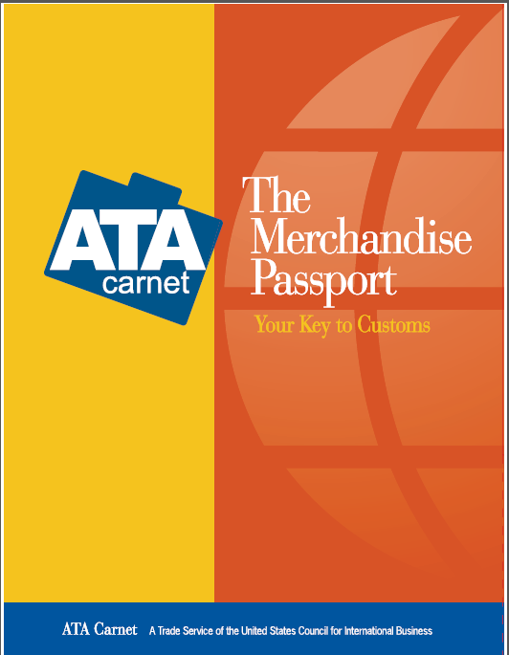
™
What Type of Goods Qualify for ATA Carnet?
3 Primary Categories:
CS--Commercial Samples
PE--Professional Equipment
EF—Goods for Exhibitions
and Fairs

Slide 9

Real Life ATA Carnet Shipments
™
Computer equipment
Wearing apparel
Billiards tables
Camera equipment
Aircraft, autos, boats
Display booths
Human skulls
Theatrical scenery
Catering equipment
Trade show booths
Jewelry
Live animals
Sporting goods
Musical instruments
Power systems
Rare books

Slide 10

™
What goods are NOT covered?
NOT covered: giveaways, food items, plants, consumables, disposable items, postal traffic and personal autos for touring
No “substantial transformation” in product or value
No repairs nor replacements

Slide 11
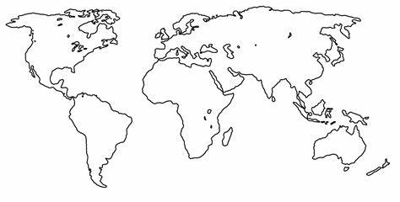
Where can ATA Carnets be used?
™
79 member countries and the customs territories they administer:
France→ Monaco
Spain→ Canary Islands
South Africa→ Namibia, Lesotho, Botswana, Swaziland

Slide 12

New ATA Carnet Countries
™
  New Members:
  2011: UAE, Bosnia Herzegovina and Mexico
  2013: Albania and Madagascar
  2014: Bahrain
  2015: Indonesia
  2017: Kazakhstan
  2018: Qatar
  2022: Vietnam

Slide 13
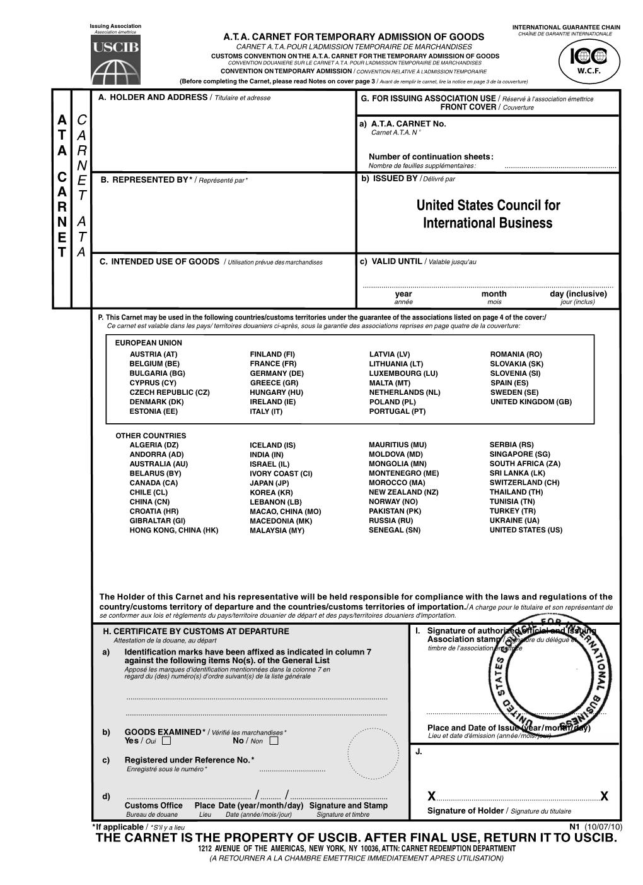
How does an ATA Carnet work?
™

Slide 14
Green Cover
™
US3/22-2456
USCIB logo
Unique identifying number
US CBP validates US Carnets on first trip out
Holder/Representative MUST sign
Acts as registration of goods returning to the U.S.
Notes:
Iran joined in late 2005, though US can not issue nor accept Carnets from Iran. Ukraine March 2008, Pakistan Oct. 2007
All items on GL should be indicated. Check inspected or not-inspected. Sign, stamp etc
Acts as a certificate of registration CF 4455, where the this certificate can only register goods with serial numbers, Carnet registers all goods with or without serial numbers

Slide 15
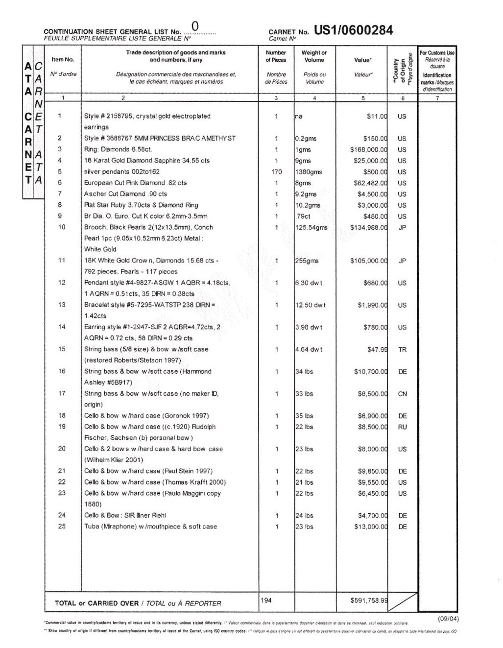
General List
™
US3/22-2456
“Reasonable” written description of goods
Serial and model nos.
Insured value, weight and origin
Group similar items
Never amend General List attached to cover, especially value
NEVER AMEND
Notes:
Iran joined in late 2005, though US can not issue nor accept Carnets from Iran. Ukraine March 2008, Pakistan Oct. 2007
All items on GL should be indicated. Check inspected or not-inspected. Sign, stamp etc
Acts as a certificate of registration CF 4455, where the this certificate can only register goods with serial numbers, Carnet registers all goods with or without serial numbers

Slide 16
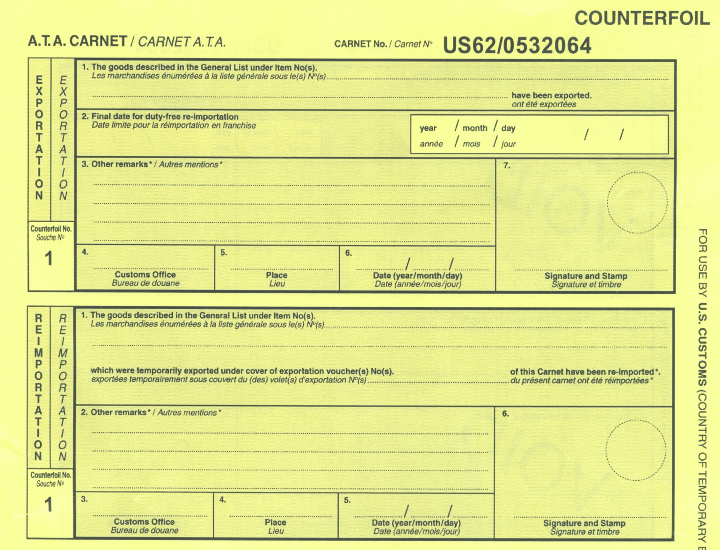
™
US3/22-2456
1 - 25
2023/10/29
Airway Bill/Bill of lading/Flight No.
No EEI per 30.37(q)***License No./ITN
U.S. Counterfoils (yellow)
3901
ORD
22/11/15
1 - 25
Airway Bill/Bill of lading/Flight No. **License No.
5309
IAH
23/11/30
Notes:
Indicate Exportation counterfoil number on re-importation counterfoil

Slide 17
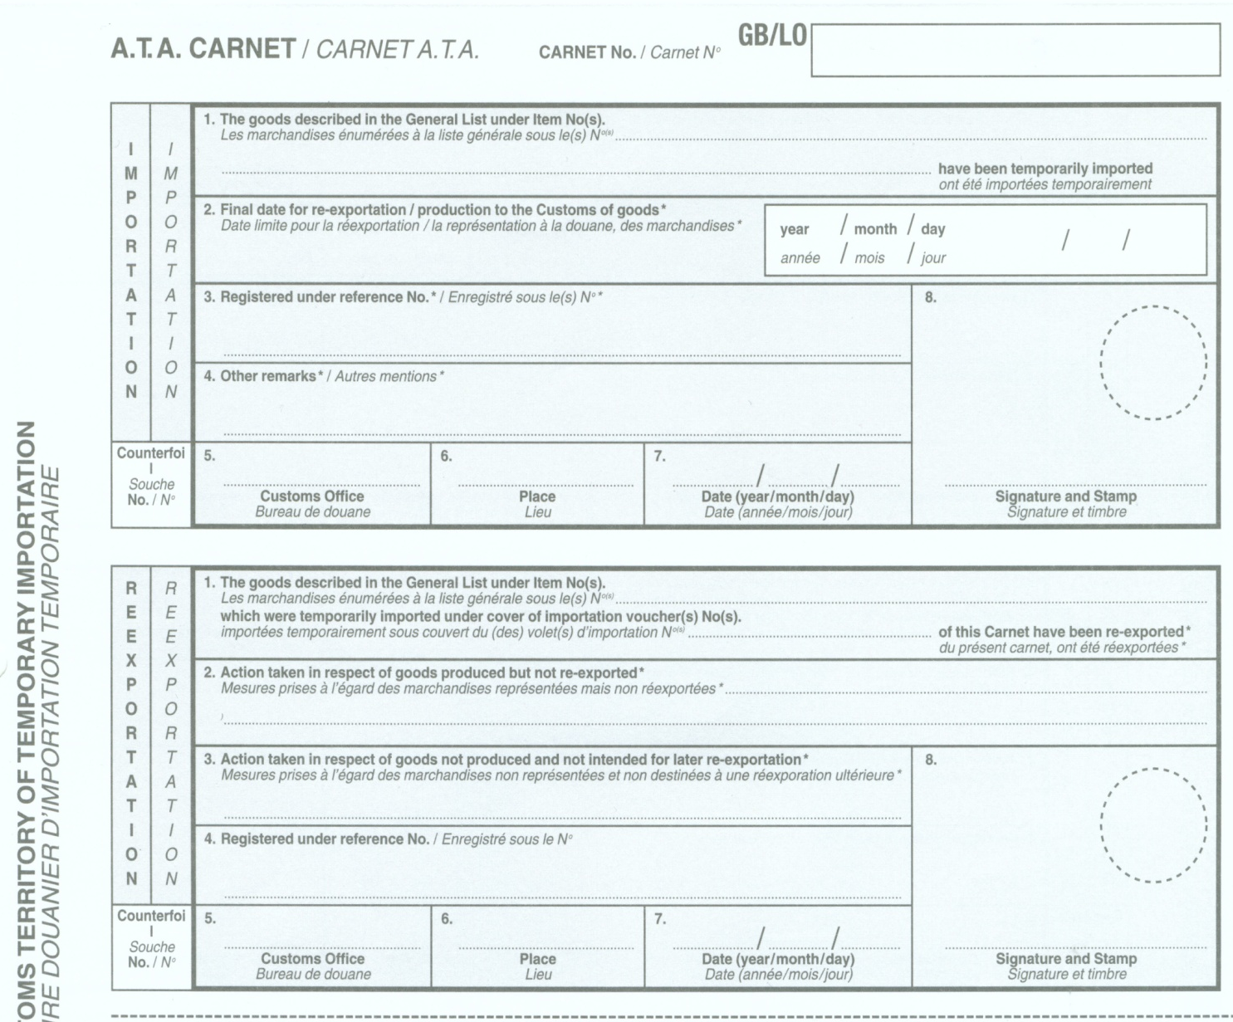
Foreign
Counterfoils
(white)
™
US3/22-2456
1 - 25
2023/04/11
Airway Bill/Bill of lading/Flight No. License No.
GB000130
LHR
22/11/15
1
1 - 25
1
Airway Bill/Bill of lading/Flight No. License No.
GB000130
LHR
22/11/29
1
Notes:
Berlin-Tegel International Airport (TXL)

Slide 18
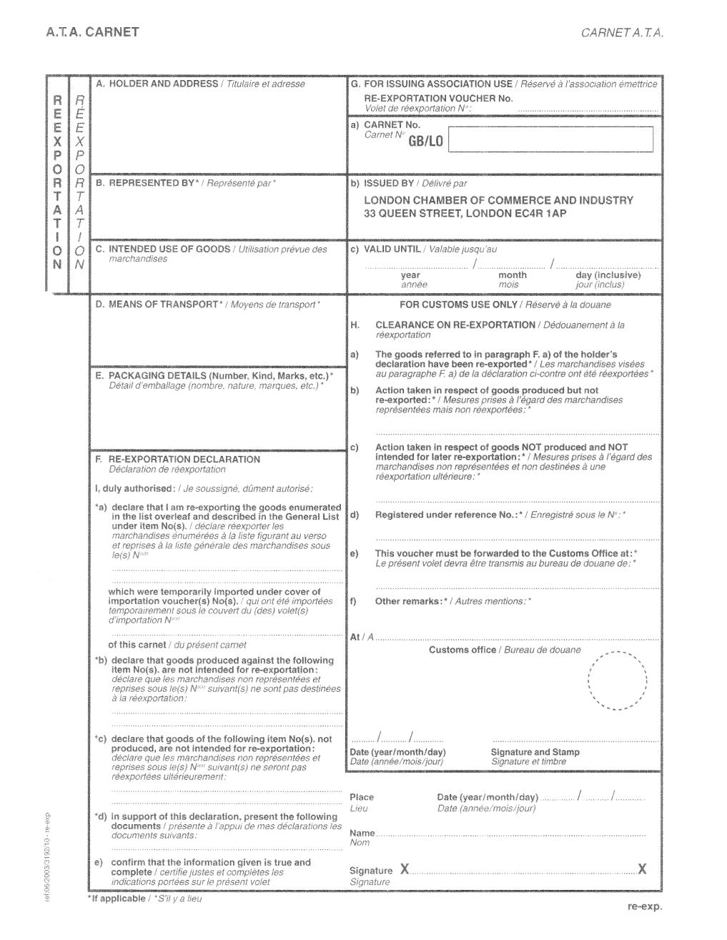
Foreign
Vouchers
(white)
™
1
US3/22-2456
US3/22-2456
2023/04/11
2023/04/11
GB000130 LHR
1 - 25
GB000130 LHR
GB000130 LHR
1- 25
2022/11/15
2022/11/29
Notes:
Emphasize that Green GL (ie the MASTER COPY) should not be amended- only cross off on VOUCHER copy
Box A-c should be filled in by Holder/issuing ofice
Bcheck/confirm box F(a) + (b) for correctness
Entry division—for larger ports, there is usually a box into which inspectors deposit the vouchers. Explain the match-up process, those without match-ups often make it to USCIB/Dale. No match-up require payment of duty.
Entering H(e), the port of entry helps CBP colleagues in Entry division assure that vouchers get to the first port of entry into the US. If the goods first enter Detroit then re-exportation voucher should be sent to Detroit even if the re-export happened in Miami.
Questions arise as to whether holders should fill out the voucher, before arriving or in view of an inspector----there is variation in port/inspector wishes. Thus, foreign holders are often not sure what to do.. Please be patient with our foreign guests.

Slide 19
ATA Carnet Best Practices
™
Box H on the Green Cover must be validated by Customs.
General List must be clearly described include any and all unique identifying characteristics.
Foreign Customs has the right to restrict entry.
Always note the ATA Carnet number on all supporting documentation.
Always notate the Airway Bill or Bill of Lading or Flight number on the counterfoils.

Slide 20
ATA Carnet Best Practices
™
Split and Partial shipments are possible, but require a lot of attention.
Ocean freight must be the last port of export. Unless its on a connecting conveyance per Muster # CCS-FY12-0031.
Request a Duplicate ATA Carnet as soon as the Original is deemed missing/lost.
***Photograph or photocopy the ATA Carnet after each time it is presented to Customs***

Slide 21

™
How do I Resolve a Claim Against My
ATA Carnet?

Slide 22
Options to Avoid or Resolve a Claim!
™
Exportation Counterfoil Stamp
Re-importation Counterfoil Stamp
Certificate of Disposition CBP form 3227
Other Customs verified related documentation
Police Report
Extending an ATA Carnet
Selling goods on an ATA Carnet
KEEP COPIES/PHOTOS
Notes:
Iran joined in late 2005, though US can not issue nor accept Carnets from Iran. Ukraine March 2008, Pakistan Oct. 2007
All items on GL should be indicated. Check inspected or not-inspected. Sign, stamp etc
Acts as a certificate of registration CF 4455, where the this certificate can only register goods with serial numbers, Carnet registers all goods with or without serial numbers

Slide 23
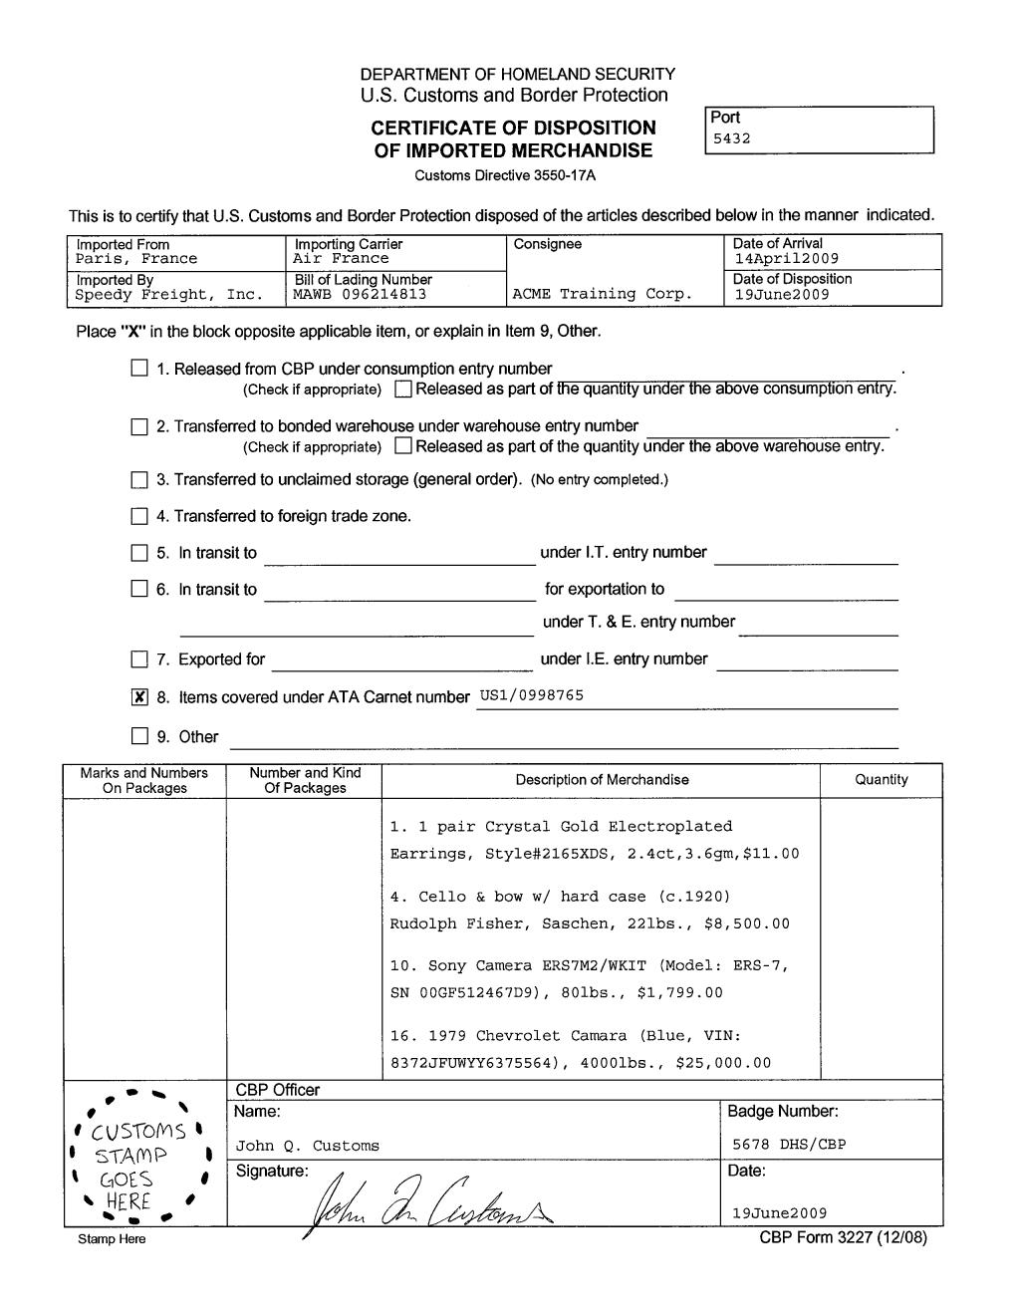
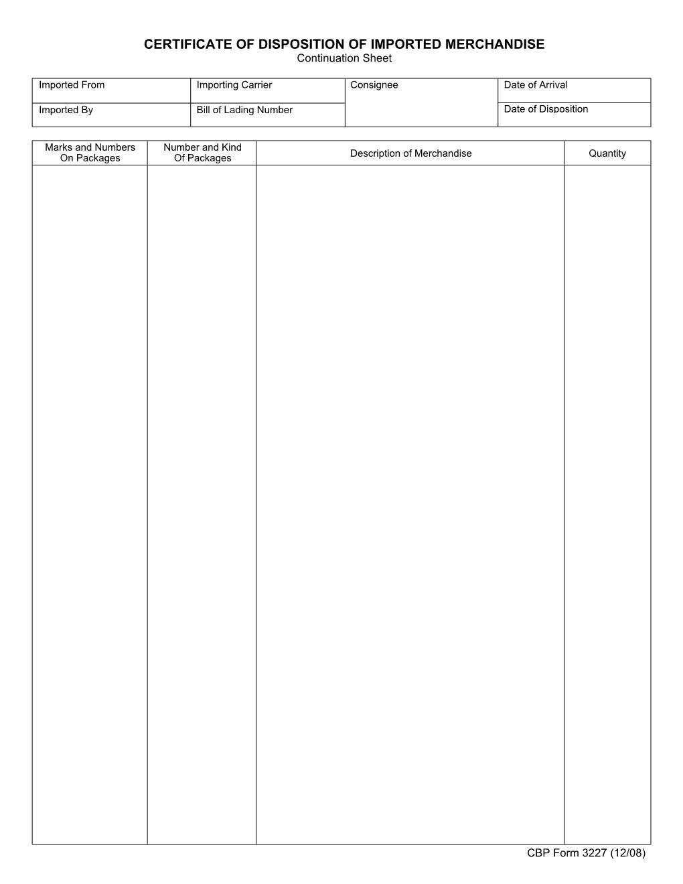
Certificate of Disposition
(CBP F 3227)
™
Notes:
Same as a citing

Slide 24
The ATA Carnet, along with the goods, must ALWAYS be together for Customs Clearance, and when in doubt call your ATA Carnet provider!
™
The Secret to ATA Carnet Compliance!

Slide 25

™
How does an Exporter get an ATA Carnet?
Notes:
Simple breaker slide.

Slide 26
™
US Customs Brokers and Freight Forwarders!

Slide 27
™
Simplified Application Process
Four Part Process:
Info on Exporter and Customs Broker and/or Freight Forwarder
Describe the goods
Countries
Security Deposit
Notes:
Good for stories

Slide 28
™
What is the Security Deposit?
  USCIB requires a security deposit
  Typically 40% of the value of the goods
    Except: India 55% and road vehicles 100%
  Two options available:
    Cash deposit
    ATA Carnet Surety bond

Slide 29
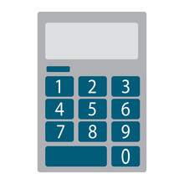
ATA Carnet Bond Calculation
™
Required security is usually 40% of the general list value
  India = 55% of the GL Value
  Auto’s (Corporations) = 100% of the GL Value
  Auto’s (Individuals) = 150% of the GL Value

Slide 30
™
How much does the ATA Carnet cost?
Basic Fee: $255-$545 based on the value of the General List. Sample: $50,000 in value and posting an ATA Carnet Surety Bond.
  Processing: $365
  Bond Prem: $200
  Total Cost: $565

Slide 31

How long does it take to get the ATA Carnet?
™
Standard Processing 2nd Business day
Rush Processing Next day
Same-Day Processing available at pick
up locations around the country.
Notes:
Good for stories

Slide 32
™
Extra Sets: additional counterfoil/voucher sets enable more country visits. Purchased after initial application
Duplicate Carnet: used for a lost, stolen or destroyed Carnet. Expiration date remains the same
Lost Document Coverage: covers the cost of obtaining a Duplicate ATA Carnet
Replacement Carnet: by foreign customs approval, extends time during which goods may remain in-country
Additional
Services
Notes:
Lost document coverage: replacing a lost ATA Carnet can result in costly replacement and delivery fees as well as lengthy delays. Purchasing lost document coverage at time of your initial ATA Carnet application is a simple and inexpensive way to eliminate these potential risks. In the event your ATA Carnet document is lost or destroyed, a duplicate is quickly issued and shipped to you at no additional cost. Otherwise, standard basic fees apply. $35

Slide 33


Thank you!
Amanda Barlow
Senior VP, Client Experience
562.628.9306
Amanda.Barlow@RoanokeGroup.com
www.RoanokeGroup.com/Solutions/ATA-Carnet
1.800.CARNET (1.800.227.6387)

